Slide 1
second Sunday of lent
Sunday 25th February, 2024
Mary Immaculate Parish Quakers Hill-Schofields
We welcome our parishioners and visitors to our Parish today.
All music reproduced with permission of ONE LICENSE No. A-642058 or
Christian Copyright Licensing International Licence No. 219857
Graphics Used with Permission of Sr Susan Daily IBVM.

Slide 2
ENTER HYMN TITLE HERE
Enter Lyrics here
Music & Lyrics By: (Insert Details)
All music reproduced with permission of ONE LICENSE No. A-642058 or
Christian Copyright Licensing International Licence No. 219857
Graphics Used with Permission of Susan Daily

Slide 3
ENTER HYMN TITLE HERE
Enter Lyrics here
Music & Lyrics By: (Insert Details)
All music reproduced with permission of ONE LICENSE No. A-642058 or
Christian Copyright Licensing International Licence No. 219857
Graphics Used with Permission of Susan Daily

Slide 4
ENTER HYMN TITLE HERE
Enter Lyrics here
Music & Lyrics By: (Insert Details)
All music reproduced with permission of ONE LICENSE No. A-642058 or
Christian Copyright Licensing International Licence No. 219857
Graphics Used with Permission of Susan Daily

Slide 5
ENTER HYMN TITLE HERE
Enter Lyrics here
Music & Lyrics By: (Insert Details)
All music reproduced with permission of ONE LICENSE No. A-642058 or
Christian Copyright Licensing International Licence No. 219857
Graphics Used with Permission of Susan Daily

Slide 6
INTRODUCTORY RITES
In the name of the Father,
and of the Son,
and of the Holy Spirit.
All: AMEN
All: AND WITH YOUR SPIRIT.

Slide 8
PENITENTIAL ACT
I confess to almighty God
and to you, my brothers and sisters,
that I have greatly sinned,
in my thoughts and in my words,
in what I have done and what I have failed to do,
through my fault, through my fault, through my most grievous fault;
therefore I ask blessed Mary ever-Virgin,
all the Angels and Saints,
and you, my brothers and sisters,
to pray for me to the Lord our God.

Slide 9
PENITENTIAL ACT
May almighty God have mercy
on us,
forgive us our sins,
and bring us to everlasting life.
All: AMEN

Slide 10
PENITENTIAL ACT
Celebrant: Lord have mercy,
All: LORD, HAVE MERCY.
Celebrant: Christ have mercy,
All: CHRIST, HAVE MERCY.
Celebrant: Lord have mercy,
All: LORD, HAVE MERCY.

Slide 12
FIRST READING
Genesis 22: 1-2 9-13 15-18

Slide 13
RESPONSORIAL PSALM
Ps 115: 10 15-19
I will walk in the presence of the Lord, in the land of the living.

Slide 14
SECOND READING
Romans 8: 31-34

Slide 15
GOSPEL ACCLAMATION
Glory and praise to you, Lord Jesus Christ! From the shining cloud the Father’s voice is heard:
this is my beloved Son, hear him.
Glory and praise to you, Lord Jesus Christ!

Slide 16
GOSPEL
The Lord be with you.
All: AND WITH YOUR SPIRIT.
A reading from the holy Gospel according to Mark.
All: Glory to you, O Lord.

Slide 17
GOSPEL
Mark 9: 2-10

Slide 19
NICENE CREED
I believe in one God, the Father Almighty,
Maker of heaven and earth, and of all things visible and invisible.
I believe in one Lord Jesus Christ, the only begotten Son of God,
Born of the Father before all ages.
God from God, light from light, True God from true God begotten, not made,
consubstantial with the father;

Slide 20
NICENE CREED
I believe in one God, the Father Almighty,
Maker of heaven and earth, and of all things visible and invisible.
I believe in one Lord Jesus Christ, the only begotten Son of God,
Born of the Father before all ages.
God from God, light from light, True God from true God begotten, not made,
consubstantial with the father;

Slide 21
NICENE CREED
He ascended into heaven and is seated at the right hand of the Father.
He will come again in glory to judge the living and the dead
And his kingdom will have no end.
I believe in the Holy Spirit, The Lord, the giver of life,
Who proceeds from the Father and the Son,
Who with the Father and the Son is adored and glorified,

Slide 22
NICENE CREED
Who has spoken through the prophets.
I believe in one, holy, catholic and apostolic Church.
I confess one Baptism for the forgiveness of sins and I look forward to the
resurrection of the dead and the life of the world to come.
Amen.

Slide 23
PRAYERS OF THE FAITHFUL
R — Lord, hear Our Prayer.

Slide 24
PARISH COMMUNITY PRAYER FOR
THE SEASON OF LENT
Loving God, During the sacred season of Lent, bring us closer to you.
Prepare a place in our homes and hearts for silence and solitude, so that we may re-discover the grace of a prayer-full life.

Slide 25
PARISH COMMUNITY PRAYER FOR
THE SEASON OF LENT
Help us to fast from those things that threaten the well-being of body and soul, remind us of the grace of simplicity.

Slide 26
Enlarge our hearts so that we give to those in need and, in doing so, re-discover the grace of gratitude and generosity.
May this season be a
grace-filled time to rekindle our love and faith in you.

Slide 28
OUR FIRST COLLECTION
supports priests currently serving in the Parramatta diocese as well as those who are retired or sick.
OUR SECOND COLLECTION
SUPPORTS OUR ON GOING OVERHEADS AND
DAY TO DAY EXPENSES OF OUR PARISH…

Slide 29
ENTER HYMN TITLE HERE
Enter Lyrics here
Music & Lyrics By: (Insert Details)
All music reproduced with permission of ONE LICENSE No. A-642058 or
Christian Copyright Licensing International Licence No. 219857
Graphics Used with Permission of Susan Daily

Slide 30
ENTER HYMN TITLE HERE
Enter Lyrics here
Music & Lyrics By: (Insert Details)
All music reproduced with permission of ONE LICENSE No. A-642058 or
Christian Copyright Licensing International Licence No. 219857
Graphics Used with Permission of Susan Daily

Slide 31
ENTER HYMN TITLE HERE
Enter Lyrics here
Music & Lyrics By: (Insert Details)
All music reproduced with permission of ONE LICENSE No. A-642058 or
Christian Copyright Licensing International Licence No. 219857
Graphics Used with Permission of Susan Daily

Slide 32
ENTER HYMN TITLE HERE
Enter Lyrics here
Music & Lyrics By: (Insert Details)
All music reproduced with permission of ONE LICENSE No. A-642058 or
Christian Copyright Licensing International Licence No. 219857
Graphics Used with Permission of Susan Daily

Slide 34
LITURGY OF THE EUCHARIST
Pray, brethren (brothers and sisters) …
All: May the Lord accept the sacrifice at your hands, for the praise and glory of his name, for our good and the good of all his holy Church.
All: AMEN
The Lord be with you.
All: AND WITH YOUR SPIRIT.
Lift up your hearts.
All: WE LIFT THEM UP TO THE LORD
Let us give thanks to the Lord our God.
All: IT IS RIGHT AND JUST.

Slide 36
SANCTUS
Holy, Holy, Holy Lord God of hosts.
Heaven and earth are full of your glory.
Hosanna in the highest.
Blessed is he who comes
In the name of the Lord.
Hosanna in the highest.
Mass of Glory & Praise - Paul Mason 2010 / Mass of St Francis – Paul Taylor 2010
All music reproduced with permission of Christian Copyright Licensing International Licence No. 219857

Slide 37
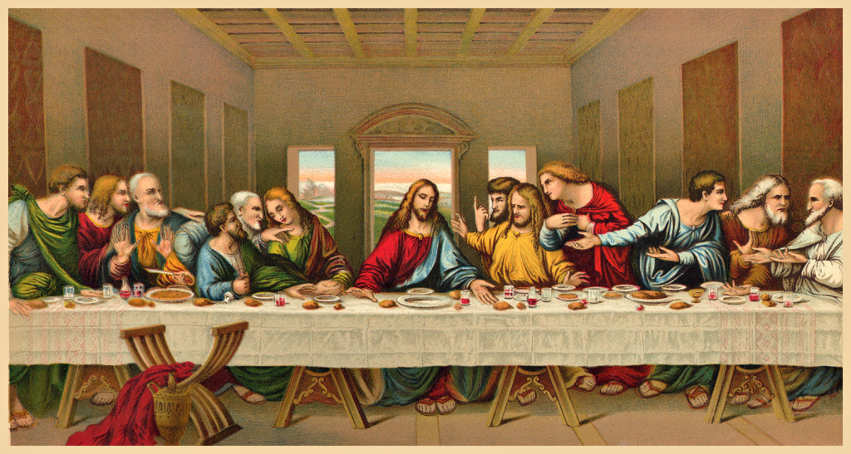

Slide 38
MYSTERY OF FAITH
We proclaim your Death, O Lord,
and profess your Resurrection
until you come again.
Mass of Glory & Praise - Paul Mason 2010 / Mass of St Francis – Paul Taylor 2010
All music reproduced with permission of Christian Copyright Licensing International Licence No. 219857

Slide 40
Through him, and with him, and in him,
O God, almighty Father, in the unity of the Holy Spirit,
all glory and honour is yours,
for ever and ever.
All: AMEN
Mass of Glory & Praise - Paul Mason 2010 / Mass of St Francis – Paul Taylor 2010
All music reproduced with permission of Christian Copyright Licensing International Licence No. 219857

Slide 41
THE LORD’S PRAYER
Our Father, Who art in heaven
Hallowed be Thy Name;
Thy kingdom come,
Thy will be done,
on earth as it is in heaven.
Give us this day our daily bread,
and forgive us our trespasses,
as we forgive those who trespass against us;
and lead us not into temptation,
but deliver us from evil. Amen.

Slide 42
Celebrant:
Deliver us, Lord, we pray……
All:
For the kingdom, the power and the glory are yours, now and for ever.

Slide 44
SIGN OF PEACE
The peace of the Lord be with you always.
All: AND WITH YOUR SPIRIT.
Let us offer each other the sign of peace.

Slide 45
BREAKING OF THE BREAD
Lamb of God, you take away the sins of the world:
Have mercy on us.
Lamb of God, you take away the sins of the world:
Have mercy on us.
Lamb of God, you take away the sins of the world:
Grant us peace.
Mass of Glory & Praise - Paul Mason 2010 / Mass of St Francis – Paul Taylor 2010
All music reproduced with permission of Christian Copyright Licensing International Licence No. 219857

Slide 46
COMMUNION
Behold the Lamb of God,
Behold him who takes away the sins of the world.
Blessed are those who are called to the supper of the Lamb.
All: Lord, I am not worthy that you should enter under my roof,
but only say the word
and my soul shall be healed.

Slide 48
ENTER HYMN TITLE HERE
Enter Lyrics here
Music & Lyrics By: (Insert Details)
All music reproduced with permission of ONE LICENSE No. A-642058 or
Christian Copyright Licensing International Licence No. 219857
Graphics Used with Permission of Susan Daily

Slide 49
ENTER HYMN TITLE HERE
Enter Lyrics here
Music & Lyrics By: (Insert Details)
All music reproduced with permission of ONE LICENSE No. A-642058 or
Christian Copyright Licensing International Licence No. 219857
Graphics Used with Permission of Susan Daily

Slide 50
ENTER HYMN TITLE HERE
Enter Lyrics here
Music & Lyrics By: (Insert Details)
All music reproduced with permission of ONE LICENSE No. A-642058 or
Christian Copyright Licensing International Licence No. 219857
Graphics Used with Permission of Susan Daily

Slide 51
ENTER HYMN TITLE HERE
Enter Lyrics here
Music & Lyrics By: (Insert Details)
All music reproduced with permission of ONE LICENSE No. A-642058 or
Christian Copyright Licensing International Licence No. 219857
Graphics Used with Permission of Susan Daily

Slide 52
OUR FIRST COLLECTION
supports priests currently serving in the Parramatta diocese as well as those who are retired or sick.
OUR SECOND COLLECTION
SUPPORTS OUR ON GOING OVERHEADS AND
DAY TO DAY EXPENSES OF OUR PARISH…

Slide 53
ENTER HYMN TITLE HERE
Enter Lyrics here
Music & Lyrics By: (Insert Details)
All music reproduced with permission of ONE LICENSE No. A-642058 or
Christian Copyright Licensing International Licence No. 219857
Graphics Used with Permission of Susan Daily

Slide 54
ENTER HYMN TITLE HERE
Enter Lyrics here
Music & Lyrics By: (Insert Details)
All music reproduced with permission of ONE LICENSE No. A-642058 or
Christian Copyright Licensing International Licence No. 219857
Graphics Used with Permission of Susan Daily

Slide 55
ENTER HYMN TITLE HERE
Enter Lyrics here
Music & Lyrics By: (Insert Details)
All music reproduced with permission of ONE LICENSE No. A-642058 or
Christian Copyright Licensing International Licence No. 219857
Graphics Used with Permission of Susan Daily

Slide 56
ENTER HYMN TITLE HERE
Enter Lyrics here
Music & Lyrics By: (Insert Details)
All music reproduced with permission of ONE LICENSE No. A-642058 or
Christian Copyright Licensing International Licence No. 219857
Graphics Used with Permission of Susan Daily

Slide 58
CONCLUDING RITE
The Lord be with you.
All: AND WITH YOUR SPIRIT.
Go ................
All: THANKS BE TO GOD

Slide 59
ENTER HYMN TITLE HERE
Enter Lyrics here
Music & Lyrics By: (Insert Details)
All music reproduced with permission of ONE LICENSE No. A-642058 or
Christian Copyright Licensing International Licence No. 219857
Graphics Used with Permission of Susan Daily

Slide 60
ENTER HYMN TITLE HERE
Enter Lyrics here
Music & Lyrics By: (Insert Details)
All music reproduced with permission of ONE LICENSE No. A-642058 or
Christian Copyright Licensing International Licence No. 219857
Graphics Used with Permission of Susan Daily

Slide 61
ENTER HYMN TITLE HERE
Enter Lyrics here
Music & Lyrics By: (Insert Details)
All music reproduced with permission of ONE LICENSE No. A-642058 or
Christian Copyright Licensing International Licence No. 219857
Graphics Used with Permission of Susan Daily

Slide 62
ENTER HYMN TITLE HERE
Enter Lyrics here
Music & Lyrics By: (Insert Details)
All music reproduced with permission of ONE LICENSE No. A-642058 or
Christian Copyright Licensing International Licence No. 219857
Graphics Used with Permission of Susan Daily

Slide 63
Second Sunday of lent
Sunday 25th February, 2024
All music reproduced with permission of ONE LICENSE No. A-642058 or
Christian Copyright Licensing International Licence No. 219857
Graphics Used with Permission of Sr Susan Daily IBVM.

