Slide 1
fourteenth Sunday in ordinary time
Sunday 7 July, 2024
Mary Immaculate Parish Quakers Hill-Schofields We welcome our parishioners and visitors to our Parish today.
Aboriginal and Torres Strait Islander Sunday
All music reproduced with permission of ONE LICENSE No. A-642058 or
Christian Copyright Licensing No. 219857
Graphics Used with Permission of Sr Susan Daily IBVM.

Slide 2
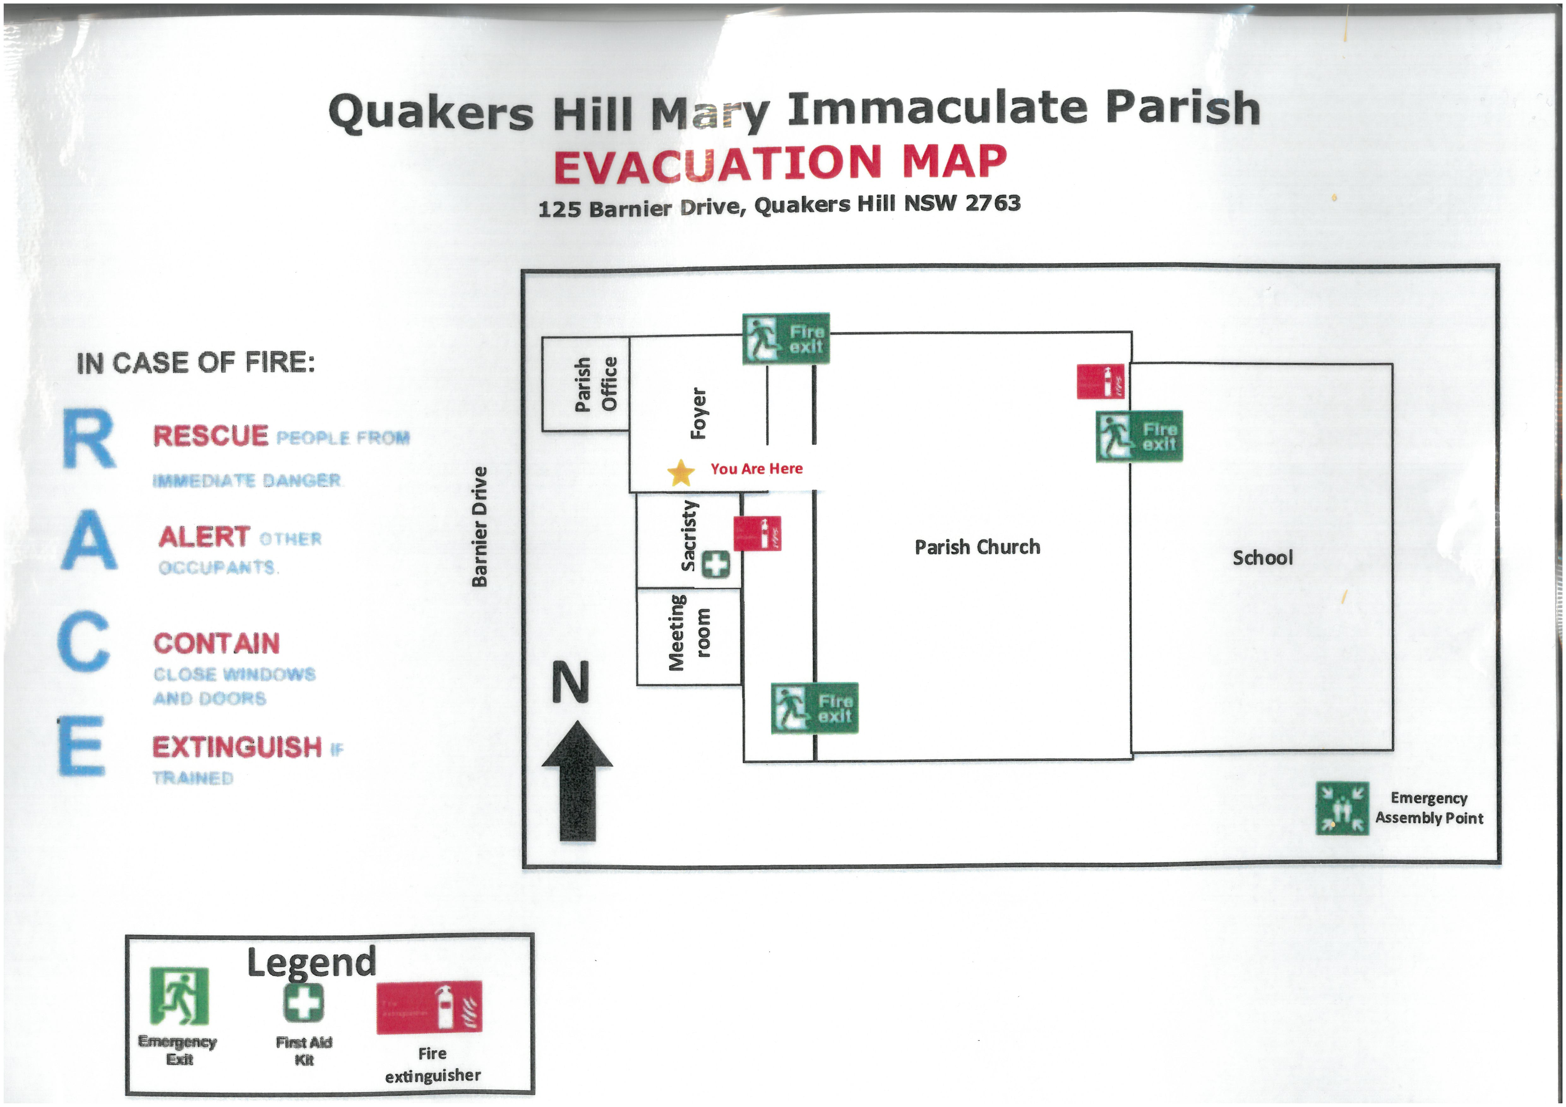
THIS WEEKENDS MASSES WILL BE OFFERED FOR
Recent Death
Anniversaries

Slide 3
Music & Lyrics By: (Please Insert Details Here)
All music reproduced with permission of ONE LICENSE No. A-642058 or
Christian Copyright Licensing No. 219857
Graphics Used with Permission of Sr Susan Daily IBVM.

Slide 4
Music & Lyrics By: (Please Insert Details Here)
All music reproduced with permission of ONE LICENSE No. A-642058 or
Christian Copyright Licensing No. 219857
Graphics Used with Permission of Sr Susan Daily IBVM.

Slide 5
Music & Lyrics By: (Please Insert Details Here)
All music reproduced with permission of ONE LICENSE No. A-642058 or
Christian Copyright Licensing No. 219857
Graphics Used with Permission of Sr Susan Daily IBVM.

Slide 6
Music & Lyrics By: (Please Insert Details Here)
All music reproduced with permission of ONE LICENSE No. A-642058 or
Christian Copyright Licensing No. 219857
Graphics Used with Permission of Sr Susan Daily IBVM.

Slide 7
INTRODUCTORY RITES
In the name of the Father,
and of the Son,
and of the Holy Spirit.
All: AMEN
All: AND WITH YOUR SPIRIT.

Slide 9
PENITENTIAL ACT
I confess to almighty God
and to you, my brothers and sisters,
that I have greatly sinned,
in my thoughts and in my words,
in what I have done and what I have failed to do,
through my fault, through my fault,

Slide 10
through my most grievous fault;
therefore I ask blessed Mary ever-Virgin,
all the Angels and Saints,
and you, my brothers and sisters,
to pray for me to the Lord our God.

Slide 11
PENITENTIAL ACT
May almighty God have mercy
on us,
forgive us our sins,
and bring us to everlasting life.
All: AMEN

Slide 12
PENITENTIAL ACT
Celebrant: Lord have mercy,
All: LORD, HAVE MERCY.
Celebrant: Christ have mercy,
All: CHRIST, HAVE MERCY.
Celebrant: Lord have mercy,
All: LORD, HAVE MERCY.

Slide 13
GLORIA
Glory to God in the highest, and on earth peace to people of good will.
We praise you,
we bless you,
we adore you,
we glorify you,
we give you thanks for your great glory,

Slide 14
Lord God, heavenly King
O God, almighty Father.
Lord Jesus Christ, Only Begotten Son,
Lord God, Lamb of God, Son of the Father,
you take away the sins of the world,
have mercy on us;
You take away the sins of the world
Receive our prayer;

Slide 15
you are seated at the right hand of the Father, have mercy on us.
For you alone are the Holy One,
you alone are the Lord,
you alone are the Most High,
Jesus Christ,
with the Holy Spirit,
in the glory of God the Father. Amen
Mass of Glory & Praise - Paul Mason 2010 / Mass of St Francis – Paul Taylor 2010
All music reproduced with permission of Christian Copyright Licensing International Licence No. 219857

Slide 17
FIRST READING
Ezekiel 2:2-5

Slide 18
RESPONSORIAL PSALM
Ps 122
Our eyes are fixed on the Lord, pleading for his mercy.

Slide 19
SECOND READING
2 Corinthians 12:7-10

Slide 20
GOSPEL ACCLAMATION
Alleluia, alleluia!
The Spirit of the Lord is upon me; he sent me to bring Good News to the poor.
Alleluia!

Slide 21
GOSPEL
The Lord be with you.
All: AND WITH YOUR SPIRIT.
A reading from the holy Gospel according to Mark.
All: Glory to you, O Lord.

Slide 22
GOSPEL
Mark 6:1-6

Slide 24
NICENE CREED
I believe in one God, the Father Almighty,
Maker of heaven and earth, and of all things visible and invisible.
I believe in one Lord Jesus Christ, the only begotten Son of God,
Born of the Father before all ages.
God from God, light from light, True God from true God begotten,

Slide 25
not made,
consubstantial with the father;
through him all things were made.
For us men and for our salvation he came down from heaven,
and by the Holy Spirit was incarnate of the Virgin Mary, and became man.
For our sake he was crucified under Pontius Pilate,

Slide 26
NICENE CREED
He suffered death and was buried,
and rose again on the third day
in accordance with the Scriptures
He ascended into heaven and is seated at the right hand of the Father.
He will come again in glory to judge the living and the dead

Slide 27
NICENE CREED
And his kingdom will have no end.
I believe in the Holy Spirit, The Lord, the giver of life,
Who proceeds from the Father and the Son,
Who with the Father and the Son is adored and glorified,
Who has spoken through the prophets.

Slide 28
NICENE CREED
I believe in one, holy, catholic and apostolic Church.
I confess one Baptism for the forgiveness of sins and I look forward to the resurrection of the dead and the life of the world to come.

Slide 29
PRAYERS OF THE FAITHFUL
R — Lord, hear our prayer.

Slide 30
ABORIGINAL & TORRES STRAIT ISLANDER PRAYER.
God of all creation, as we journey together in this Great Southern Land, we pray for healing, forgiveness and unity, creating a path of good will, with justice and compassion.

Slide 31
ABORIGINAL & TORRES STRAIT ISLANDER PRAYER.
Jesus, through the power of your love, you have given us the courage, wisdom and strength to share our gifts and talents in humility.
In peace and understanding we reconcile with each other.

Slide 32
ABORIGINAL & TORRES STRAIT ISLANDER PRAYER.
Creator Spirit, we come together in prayer and thanksgiving for the many blessings we have received. Allow your Spirit to wash over us and give us strength to walk together as one.

Slide 34
OUR FIRST COLLECTION
supports priests currently serving in the Parramatta diocese as well as those who are retired or sick.
OUR SECOND COLLECTION
SUPPORTS OUR ON GOING OVERHEADS AND
DAY TO DAY EXPENSES OF OUR PARISH…

Slide 35
Music & Lyrics By: (Please Insert Details Here)
All music reproduced with permission of ONE LICENSE No. A-642058 or
Christian Copyright Licensing No. 21987
Graphics Used with Permission of Sr Susan Daily IBVM.

Slide 36
Music & Lyrics By: (Please Insert Details Here)
All music reproduced with permission of ONE LICENSE No. A-642058 or
Christian Copyright Licensing No. 21987
Graphics Used with Permission of Sr Susan Daily IBVM.

Slide 37
Music & Lyrics By: (Please Insert Details Here)
All music reproduced with permission of ONE LICENSE No. A-642058 or
Christian Copyright Licensing No. 21987
Graphics Used with Permission of Sr Susan Daily IBVM.

Slide 38
Music & Lyrics By: (Please Insert Details Here)
All music reproduced with permission of ONE LICENSE No. A-642058 or
Christian Copyright Licensing No. 21987
Graphics Used with Permission of Sr Susan Daily IBVM.

Slide 40
LITURGY OF THE EUCHARIST
Pray, brethren (brothers and sisters) …
All: May the Lord accept the sacrifice at your hands, for the praise and glory of his name, for our good and the good of all his holy
Church.
All: AMEN

Slide 42
SANCTUS
Holy, Holy, Holy Lord God of hosts.
Heaven and earth are full of your glory.
Hosanna in the highest.
Blessed is he who comes
In the name of the Lord.
Hosanna in the highest.
Mass of Glory & Praise - Paul Mason 2010 / Mass of St Francis – Paul Taylor 2010
All music reproduced with permission of Christian Copyright Licensing International Licence No. 219857

Slide 43
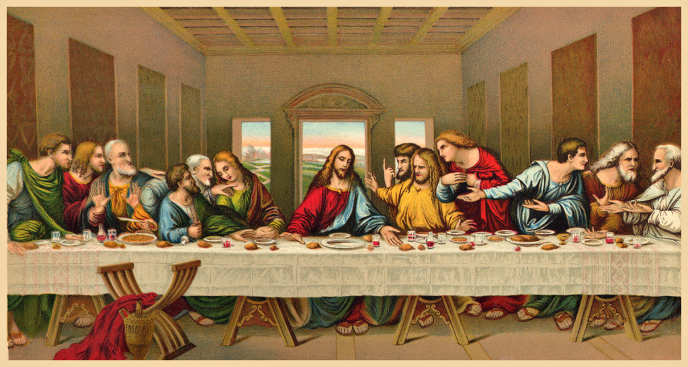

Slide 44
MYSTERY OF FAITH
(Option 1)
We proclaim your Death, O Lord,
and profess your Resurrection
until you come again.
Mass of Glory & Praise - Paul Mason 2010 / Mass of St Francis – Paul Taylor 2010
All music reproduced with permission of Christian Copyright Licensing International Licence No. 219857

Slide 45
MYSTERY OF FAITH
(Option 2)
When we eat this Bread and drink this Cup,
we proclaim your Death, O Lord,
until you come again.
Mass of Glory & Praise - Paul Mason 2010 / Mass of St Francis – Paul Taylor 2010
All music reproduced with permission of Christian Copyright Licensing International Licence No. 219857

Slide 46
MYSTERY OF FAITH
(Option 3)
Save us, Saviour of the world, for by your Cross and Resurrection
you have set us free.
Mass of Glory & Praise - Paul Mason 2010 / Mass of St Francis – Paul Taylor 2010
All music reproduced with permission of Christian Copyright Licensing International Licence No. 219857

Slide 48
Through him, and with him, and in him,
O God, almighty Father, in the unity of the Holy Spirit,
all glory and honour is yours,
for ever and ever.
All: AMEN
Mass of Glory & Praise - Paul Mason 2010 / Mass of St Francis – Paul Taylor 2010
All music reproduced with permission of Christian Copyright Licensing International Licence No. 219857

Slide 49
THE LORD’S PRAYER
Our Father, Who art in heaven
Hallowed be Thy Name;
Thy kingdom come,
Thy will be done,
on earth as it is in heaven.
Give us this day our daily bread,
and forgive us our trespasses,

Slide 50
THE LORD’S PRAYER
as we forgive those who trespass against us;
and lead us not into temptation,
but deliver us from evil.

Slide 51
Celebrant:
Deliver us, Lord, we pray…
All:
For the kingdom, the power
and the glory are yours, now
and for ever.

Slide 53
SIGN OF PEACE
The peace of the Lord be with you always.
All: AND WITH YOUR SPIRIT.
Let us offer each other the sign of peace.

Slide 54
BREAKING OF THE BREAD
Lamb of God, you take away the sins of the world:
Have mercy on us.
Lamb of God, you take away the sins of the world:
Have mercy on us.
Mass of Glory & Praise - Paul Mason 2010 / Mass of St Francis – Paul Taylor 2010
All music reproduced with permission of Christian Copyright Licensing International Licence No. 219857

Slide 55
BREAKING OF THE BREAD
Lamb of God, you take away the sins of the world:
Grant us peace.
Mass of Glory & Praise - Paul Mason 2010 / Mass of St Francis – Paul Taylor 2010
All music reproduced with permission of Christian Copyright Licensing International Licence No. 219857

Slide 56
COMMUNION
Behold the Lamb of God,
Behold him who takes away the sins of the world.
Blessed are those who are called to the supper of the Lamb.

Slide 57
COMMUNION
All: Lord, I am not worthy that you should enter under my roof,
but only say the word
and my soul shall be healed.

Slide 59
Music & Lyrics By: (Please Insert Details Here)
All music reproduced with permission of ONE LICENSE No. A-642058 or
Christian Copyright Licensing No. 219857
Graphics Used with Permission of Sr Susan Daily IBVM.

Slide 60
Music & Lyrics By: (Please Insert Details Here)
All music reproduced with permission of ONE LICENSE No. A-642058 or
Christian Copyright Licensing No. 219857
Graphics Used with Permission of Sr Susan Daily IBVM.

Slide 61
Music & Lyrics By: (Please Insert Details Here)
All music reproduced with permission of ONE LICENSE No. A-642058 or
Christian Copyright Licensing No. 219857
Graphics Used with Permission of Sr Susan Daily IBVM.

Slide 62
Music & Lyrics By: (Please Insert Details Here)
All music reproduced with permission of ONE LICENSE No. A-642058 or
Christian Copyright Licensing No. 219857
Graphics Used with Permission of Sr Susan Daily IBVM.

Slide 63
OUR FIRST COLLECTION
supports priests currently serving in the Parramatta diocese as well as those who are retired or sick.
OUR SECOND COLLECTION
SUPPORTS OUR ON GOING OVERHEADS AND
DAY TO DAY EXPENSES OF OUR PARISH…

Slide 64
Music & Lyrics By: (Please Insert Details Here)
All music reproduced with permission of ONE LICENSE No. A-642058 or
Christian Copyright Licensing No. 219857
Graphics Used with Permission of Sr Susan Daily IBVM.

Slide 65
Music & Lyrics By: (Please Insert Details Here)
All music reproduced with permission of ONE LICENSE No. A-642058 or
Christian Copyright Licensing No. 219857
Graphics Used with Permission of Sr Susan Daily IBVM.

Slide 66
Music & Lyrics By: (Please Insert Details Here)
All music reproduced with permission of ONE LICENSE No. A-642058 or
Christian Copyright Licensing No. 219857
Graphics Used with Permission of Sr Susan Daily IBVM.

Slide 67
Music & Lyrics By: (Please Insert Details Here)
All music reproduced with permission of ONE LICENSE No. A-642058 or
Christian Copyright Licensing No. 219857
Graphics Used with Permission of Sr Susan Daily IBVM.

Slide 69
CONCLUDING RITE
The Lord be with you.
All: AND WITH YOUR SPIRIT.
Go ................
All: THANKS BE TO GOD

Slide 70
Music & Lyrics By: (Please Insert Details Here)
All music reproduced with permission of ONE LICENSE No. A-642058 or
Christian Copyright Licensing No. 219857
Graphics Used with Permission of Sr Susan Daily IBVM.

Slide 71
Music & Lyrics By: (Please Insert Details Here)
All music reproduced with permission of ONE LICENSE No. A-642058 or
Christian Copyright Licensing No. 219857
Graphics Used with Permission of Sr Susan Daily IBVM.

Slide 72
Music & Lyrics By: (Please Insert Details Here)
All music reproduced with permission of ONE LICENSE No. A-642058 or
Christian Copyright Licensing No. 219857
Graphics Used with Permission of Sr Susan Daily IBVM.

Slide 73
Music & Lyrics By: (Please Insert Details Here)
All music reproduced with permission of ONE LICENSE No. A-642058 or
Christian Copyright Licensing No. 219857
Graphics Used with Permission of Sr Susan Daily IBVM.

Slide 74
fourteenth Sunday in ordinary time
Sunday 7 July, 2024
All music reproduced with permission of ONE LICENSE No. A-642058 or
Christian Copyright Licensing No. 21987
Graphics Used with Permission of Sr Susan Daily IBVM.

