Slide 1

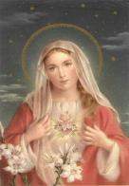
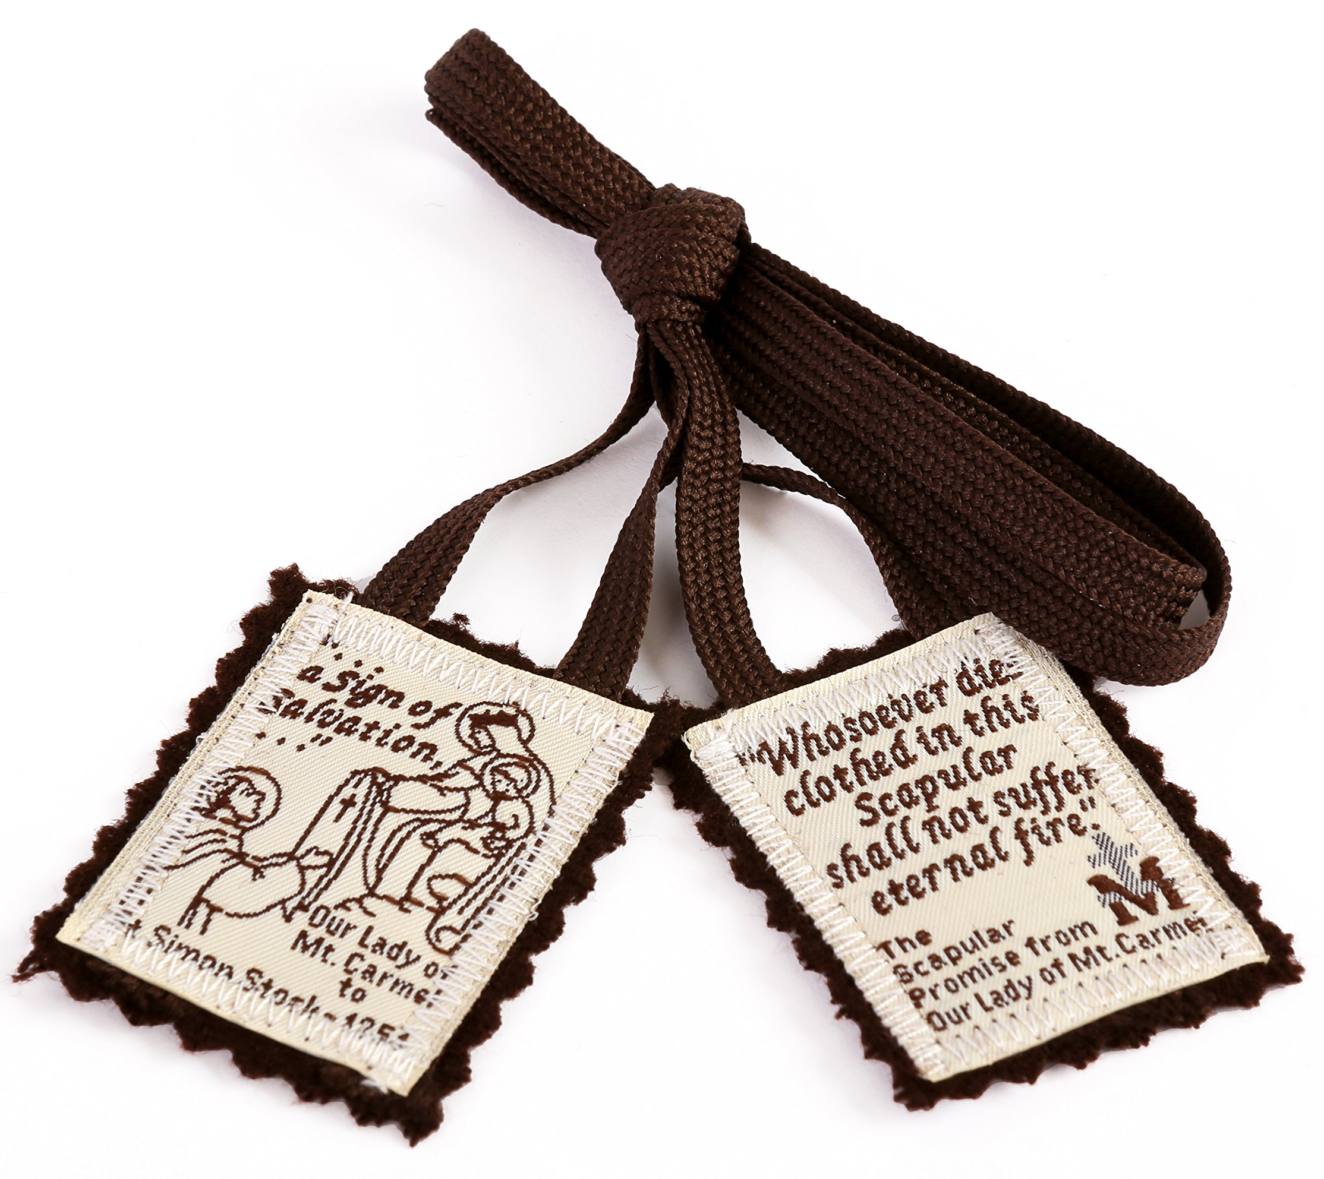




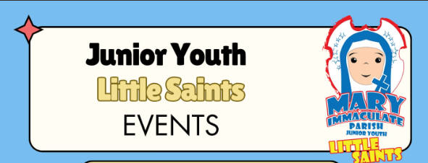
R.C.I.A ENROLMENT
Mary Immaculate Parish
The RCIA program for this year will begin early on the 15th of June. If you, or someone you know, is interested in learning more about the Catholic faith, preparing for Baptism, Confirmation, or being received into the Church, we invite you to enrol. Please contact the parish office via emailparishoffice@maryimmac.org.au for enrolment details We encourage you to spread the word to family and friends who may be interested.
ROSARY AT THE GROTTO
Quakers Hill—Schofields
125 Barnier Drive, Quakers Hill, NSW 2763
PH 9626 3326
Website: www.maryimmac.org.au ABN 93 648 688 769
The Legion of Mary devotees will be praying the Rosary for World Peace on Wednesday 15th July at 3.00pm. All are welcome to join them.
BULLETIN
4 October 2026
PENTECOST SUNDAY 24 MAY
Twenty- Seventh Sunday in Ordinary Time~ YEAR A
ATTENTION
MASS TIME CHANGES FROM 12TH- 15TH OCTOBER
DAILY MASS READINGS: 5- 10 October
There will be NO 6.00am MASSES offered on Monday the 12 until Thursday 15.
There will be only the 9:15am Masses available in the parish from the 13-15 October.
No Wednesday evening 14 October Novena Mass.
Normal 6.00am & 9.15am Masses on Friday 16th.
We apologise for any inconvenience this may cause.
There are morning Masses available at Our Lady of the Rosary Kellyville, Our Lady of the Angels Rouse Hill and St John’s in Riverstone. Please see their websites for more details.
Mon 5 October: Gal 1:6-12& Lk 10:25-37
Tues 6 October: Gal 1:13-24 & Lk 10:38-42
Wed 7 October: Gal 2:1-2, 7-14 & Lk 11:1-4
Thurs 8 October: Gal 3:1-5& Lk 11:5-13
Fri 9 October: Gal 3:7-14 & Lk 11:15-26
Sat 10 October: Gal 3:22-29 & Lk 11:27-28
Each year, Mary Immaculate Parish celebrates Pentecost with a bountiful food fair. Highlighting the rich cultural diversity of our Catholic community. This year, we thought to change things up a bit. We are proposing that we celebrate the occasion at the 9am Mass followed by a shared meal. We would like to encourage those attending to simply come in your cultural dress to Mass and bring a plate to share with others following Mass. This will be a free event with free tea and coffee. It is the time in the year when we celebrate the Church's birthday. We hope to see you there.
CONGRATULATIONS TO OUR CONFORMANDS
ROSARY AT THE GROTTO
The parish would like to congratulate all the children who have just received the Sacrament of Confirmation. They were both beautiful liturgies. We hope each of them continue to share what they have received and reveal to the world the love that God has for us. A big thank you to all those who assisted in their preparation.
The Legion of Mary devotees will be praying the
Rosary for World Peace on Wednesday 20th October at 3.00pm. All are welcome to join them.
MEN AT THE SHRINE
Is a monthly hour of adoration at the Schoenstatt Shrine in Mulgoa, held on the second Wednesday of each month. The hour begins with a brief reflection before a time of silent prayer. Confessions are available. The evening finishes with a cup of tea. All men are welcome. No RSVP is necessary. Find the event on Facebook, or contact Bernard, 0416 106 871.
The Youth Group’s are inviting you to come and spend an hour with Jesus in adoration. Friday night 22nd May 2026 from 7pm-8pm. This holy hour will be to pray for all the sick and those who have asked for our prayers.
SACRAMENT OF RECONCILIATION REGISTRATION
PARISH VISION & MISSION
Registrations for the Sacrament of Reconciliation is open. If you wish your child to receive this sacrament in preparation for First Holy Communion in 2027, please go to our website under the Sacraments Tab to find the link and register. This Sacrament is for those children who are in grade 3 or above. Preparations for the Sacrament will begin on the 26th of October and reception of Reconciliation will take place on 19th of November. Contact the Parish Office for more info.
Our Vision Statement is:
To create a vibrant, loving Catholic community that inspires and empowers members to make a positive impact in our world.
Our Mission Statement is:
To provide an inclusive, engaging environment for members to deepen their faith, use their talents to serve others, and make a positive impact in our world.
DEEPENING YOUR FAITH
These sessions are commencing Thursday 6th August after the 9.15am Mass in the Parish meeting Room.
If you would like to refresh your knowledge or learn more about your faith, you are invited to join us for a "cuppa", a DVD, a little sharing and prayer. We use the readings of the following Sunday to help deepen our faith further. No need to book. All are welcome! For enquiries phone the parish office 9626 3326
WE REMEMBER IN OUR PRAYER
HEALING MASS
Sick:
The healing Mass will be on Saturday 26th September at 7.30am here in our parish. All are welcome to attend.
Theresa Briffa, Felix D’Souza, Florance Heredia, Asmando Bautista, Bartolome Abad, Caden Vidal, Antonette Grech, Charito Angeles, Perlita Cadungog, Anna Fernandes, Robert Penafuerte, Theresa Briffa, Ruth M. Manansala, Rosita Ludowyke, Precious Guerrero Tamayo, Caroline Dias, Clarina Emanuel, Sr. Paulina, Rolly Valenzuela, Tita Garcia, Michael McTegg, Jaythde Hite-Deuna, Phillip Camilleri, Margaret Deshe, Resurrettion & Grace Espina, Graham Rutledge, Madeline Semisi, Ray Johnston, Sophia Pal, Harrison Whelan, Joseph Buttigieg, Jackson Naidoo, Aylyn Yu, Raymond Gajitos & Ruby L.
Recently Deceased:
Jennifer Alam, Concepcion Abonales, Bienvenido de Jesus, Soledad Kanty, Pauline Cox, Magda Rezk, Elizabeth Garcia
Anniversaries:
Walter Valenton, Maria Dass,
George Menezes, Amelia Acuna
CHILDREN’S LITURGY
There will be NO Children’s Liturgy during school
holidays and will resume back on Sunday 18
October during the 9.00am & 10.30am Masses.
THE MARY IMMACULATE SEPTET CHOIR
The Mary Immaculate Septet Choir is seeking a pianist/organist and interested Parishioners willing to sing and serve in the music ministry. We sing on the 5th Sunday at the 9 am Mass. (4-5 sessions a year). Please contact the Parish Office or Tania on 0405820073.
In Memoriam:
Miguela Guanzon, Joseph Tuoc Van Do, Elmer Luspo, Marie McLaughin, Leli Arapa, Lorna Hall, Hulya Ipek, Joselito Lapitan, Jun Jun Mirasol, Clementina Romero, Carmelita Datan, Guillermo Roque III, Mona Canares, Amelia Celocia, Raji John, Ephram & Francis, Bill Azzopardi, Antony Farrugia, Reggie & Maria Victoria Dalgado, John Quattromani, Joseph & Loretta Desa, Joseph Steven Camilleri, Epifanio Serrano, Mary Lucille Serrano, Roberto Serrano, Claude & Rita Joachim, Irene Dassanayaka, Regina—Benito Franado, Roberto—Maria Reyes, Antonio—Lucia Santos, Regina & baby Granado, Hugo Sr.& Marita Agudo, Dominador Snr & Efigenia Granado, John & Frances Micallef, Stuart Richard, Dan Peiris, Nilo Abalos, Eugenio De Jesus Jr., Goring Bacalso, All who died in war, & all the souls in purgatory.
May they Rest in Peace
The Vigil Mass on Saturday 5 September 5.30pm will be celebrated with Our Little Saints participating in the readings and the choir. All are welcomed to attend!

Slide 2
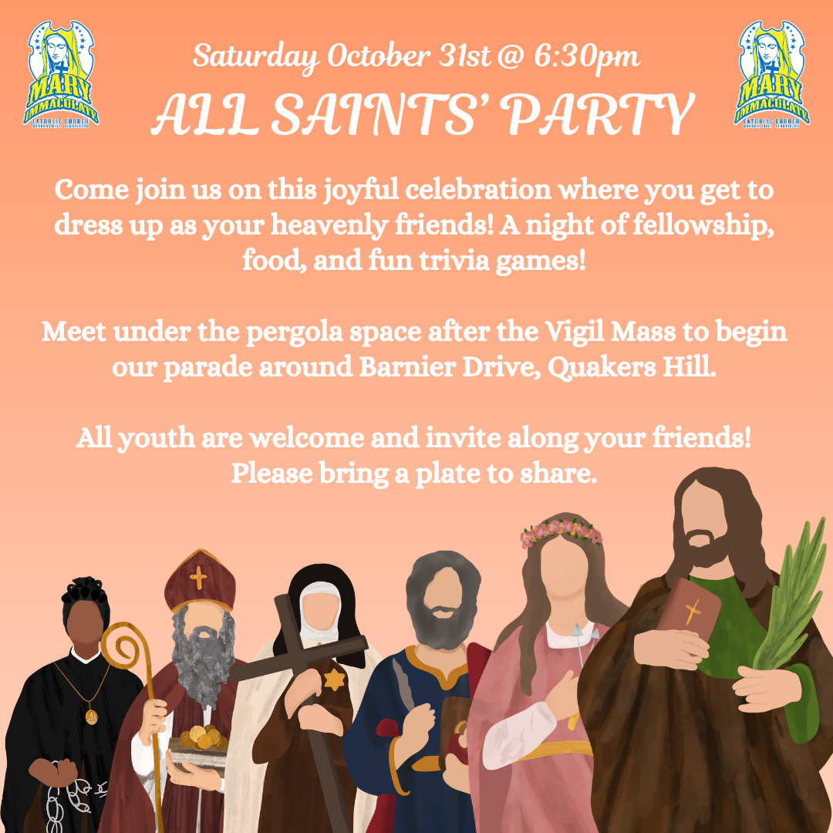



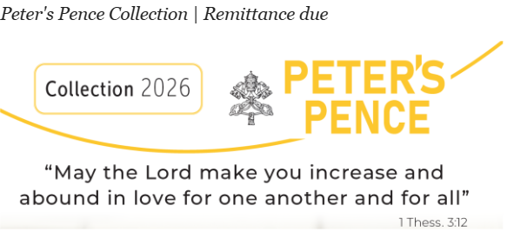

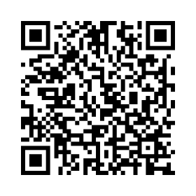
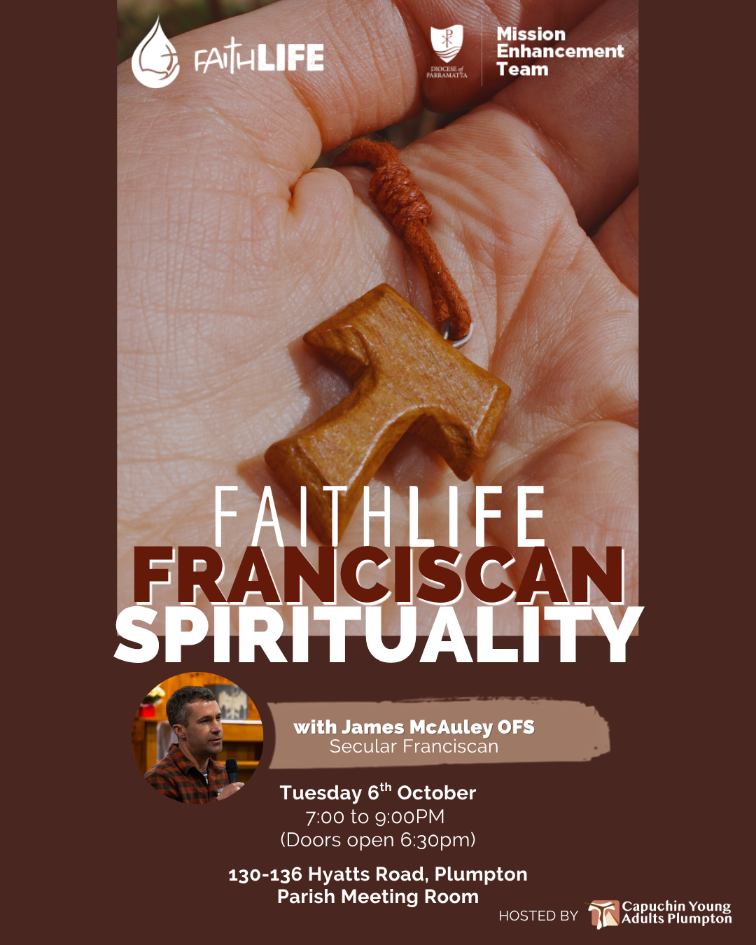
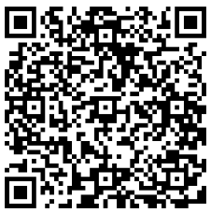

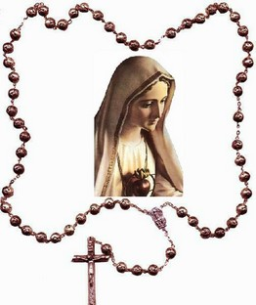
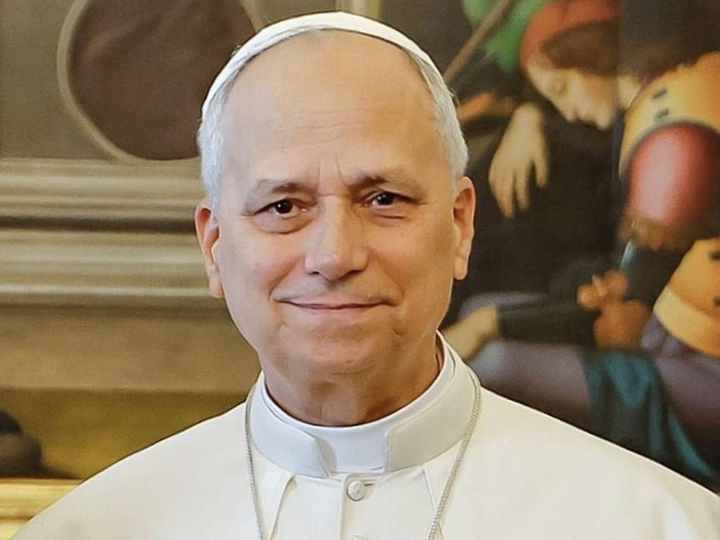
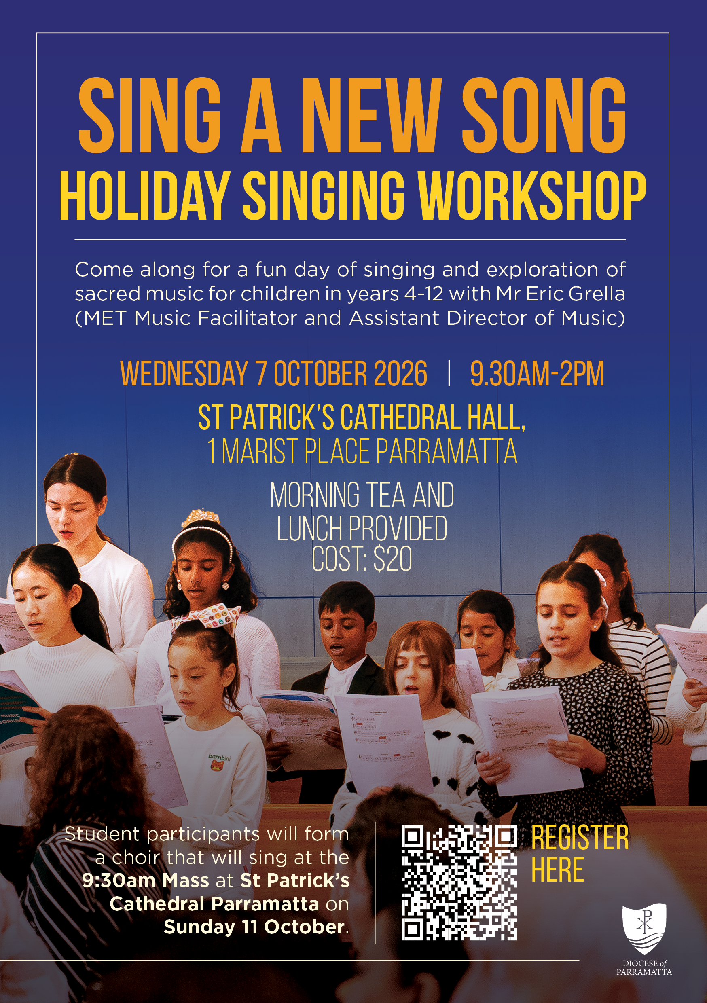

The RCIA program for this year will begin on October 12th 2026. It will end on Easter 2027.
If you, or someone you know, is interested in learning more about the Catholic faith, preparing for Baptism, Confirmation, or being received into the Church as an adult, we invite you to enrol. Please contact the parish office or check the notice board for enrolment details. We encourage you to spread the word to family and friends who may be interested.
Thank you, and God bless.
SAVE THE DATE 6TH DECEMBER 2026
These sessions will be held on the 1st and 3rd Thursdays of every month. Our next get together will be on 15th October after the 9.15am Mass in the Parish meeting Room.
If you would like to refresh your knowledge or learn more about your faith, you are invited to join us for a "cuppa", We use the readings of the following Sunday to help deepen our faith further. No need to book. All are welcome!
On the 6th of December, the parish will be having its annual Parish Summer Feast Day Celebration. We hope to have a number of activities on the day. If you wish to assist in preparations or on the day, please contact Anthony in the Parish Office.
RCIA PROGRAM
SUMMARY OF POPE’S LEO XIV REFLECTION ON SACRED MUSIC19TH AUGUST 2026
DEEPENING YOUR FAITH
ROSARY AT THE GROTTO
The Legion of Mary devotees will be praying the Rosary for World Peace on Wednesday 21 October at 3.00pm. All are welcome to join them.
SEEKING VOLENTARY WORK MEN
PARISH LADIES GROUP
CYMI
The parish is seeking for some abled bodied men who have some time in their busy schedules to assist with some voluntary fix-it issues that might arise from time to time in the church. If you have experience in some trades and willing to volunteer some of your time, please contact the Parish Office.
Congratulations to the winner of the Mother’s Day raffle: Lorraine Quinn. They will announce how much was raised next week.
Calling all youth aged 12-17: Join us and
Blaze Youth from Saint John XXIII for a day of
faith, friendship, fun and encountering Christ!
We will have games and icebreakers, group
activities, talks from guest speakers,
Adoration and Mass. Our theme is "Living in Christ".
LIVING IN CHRIST – CYMI x Blaze Youth Retreat
📅 Date: Saturday, 12th December 2026
⏰ Time: 9am – 3pm
📍 Location: Franciscan Shrine
of the Holy Innocents, Kellyville
Registration QR code:
Happy 99th Birthday
Paul Dimech
WHAT A TREAT — AND WHAT WONDERFUL SUPPORT!
SACRAMENT OF CONFIRMATION
Registrations for the Sacrament of Confirmation have now closed. The Sacramental Team will be in touch with all the enrolled parents via email early next week. Please arrive 10 minutes before the start of the first lesson to start on time. Looking forward to seeing all the parents and children. Any questions, please email the Parish Office.
MARY IMMACULATE’S COMMITMENT TO SAFEGUARDING
REFRESHER SAFEGUARDING TRAINING – MODULE 6
(CYCLE 3)
A Safe Church is a Strong Church!
Mary Immaculate is committed to providing a safe and welcoming environment and takes the safeguarding of children and vulnerable persons seriously.
Safeguarding those who are vulnerable is part of the mission that Jesus Christ entrusts to our Church. We all have a role to play in safeguarding those who are vulnerable.
If you have any concerns about someone’s immediate safety, or you suspect a crime may have or is likely to occur, please contact NSW Police on Triple Zero (000).
Concerns about safeguarding in the Diocese may be referred to the Parish Office, or directly to the:
Office for Safeguarding and Professional Standards
Ph (02) 8838 3419
Email: safeguarding@parracatholic.org.
Information about the Diocese’s response and supports
about safeguarding children and vulnerable people are available at www.safeguarding.org.au
Safeguarding training is due to be updated every two years.
Have you completed the Introductory and Renewal Modules 1-5? If 2 years have passed please complete Refresher Module 6.
Module 6 is being offered face to face at Bishop Bede Heather Centre Blacktown on Tuesday 28th July 2026.
A morning session will take place between 10am and 12 noon. This Module will also be repeated in the evening between 7pm-9pm. Please register for one of these sessions via the website or email: safeguardingtraining@parracatholic.org
This Module is also available online at:
https://learning.safeguarding.org.au/
MEN AT THE SHRINE
Is a monthly hour of adoration at the Schoenstatt Shrine in Mulgoa, held on the second Wednesday of each month. The hour begins with a brief reflection before a time of silent prayer. Confessions are available. The evening finishes with a cup of tea. All men are welcome. No RSVP is necessary. Find the event on Facebook, or contact Bernard, 0416 106 871.
The Father’s Day Appeal started on 29th of August to the 20th of September by using the envelopes or scanning the QR code.
Please give generously.
Happy 37th Wedding Anniversary
Ariel and Faye Demagante
These sessions are commencing Thursday 6th August after the 9.15am Mass in the Parish meeting Room.
If you would like to refresh your knowledge or learn more about your faith, you are invited to join us for a "cuppa", a DVD, a little sharing and prayer. We use the readings of the following Sunday to help deepen our faith further. No need to book. All are welcome! For enquiries phone the parish office 9626 3326
EMMAUS ENCOUNTERS - WALKING TOGETHER
MARY IMMACULATE’S COMMITMENT TO SAFEGUARDING
A Safe Church is a Strong Church!
Mary Immaculate is committed to providing a safe and welcoming environment and takes the safeguarding of children and vulnerable persons seriously.
Safeguarding those who are vulnerable is part of the mission that Jesus Christ entrusts to our Church. We all have a role to play in safeguarding those who are vulnerable.
If you have any concerns about someone’s immediate safety, or you suspect a crime may have or is likely to occur, please contact NSW Police on Triple Zero (000). Concerns about safeguarding in the Diocese may be referred to the Parish Office, or directly to the: Office for Safeguarding and Professional Standards Ph (02) 8838 3419
Email: safeguarding@parracatholic.org.
Information about the Diocese’s response and supports
about safeguarding children and vulnerable people are available at www.safeguarding.org.au
Our Emmaus Encounters are a wonderful opportunity for our Mary Immaculate students and parish “Wisdom Figures” to come together in conversation, sharing stories, faith and life experiences. Through these encounters, students are encouraged to put their faith into action, recognizing the face of Christ in one another as we journey together.
We warmly invite our selected parishioners to join us on 25 September at 10:00am, following morning Mass. We would love you to be part of these special intergenerational encounters with our students.
“Take courage! I have overcome the world” (Jn 16:33)
World Youth Day, the biggest Catholic Young Adult event, is happening next year in South Korea. It brings together young Catholics from around the world to celebrate our faith, meet people from different countries and cultures, and share experiences with others on the same faith journey.
Many young people expressed interest in attending. Fr Oliver has confirmed four young adults who will represent Mary Immaculate in Korea: Scott, Isabelle, Katie and Matthew. They will be asking for your prayers and donations to support their journey.
These four have long been active in our parish through music ministry, youth ministry, SRE and volunteering at parish events. Please keep them in your prayers and come support them once fundraising begins.

Slide 3

TWENTY-SEVENTH SUNDAY IN ORDINARY TIME ~ YEAR A ~ 4 OCTOBER 2026
First Reading Isaiah 5:1-7
A reading from the prophet Isaiah
Let me sing to my friend the song of his love for
his vineyard. My friend had a vineyard on a
fertile hillside. He dug the soil, cleared it of stones,
and planted choice vines in it.
In the middle he built a tower, he dug a press
there too. He expected it to yield grapes,
but sour grapes were all that it gave.
And now, inhabitants of Jerusalem
and men of Judah, I ask you to judge
between my vineyard and me.
What could I have done for my vineyard
that I have not done?
I expected it to yield grapes.
Why did it yield sour grapes instead?
Very well, I will tell you
what I am going to do to my vineyard:
I will take away its hedge for it to be grazed on,
and knock down its wall for it to be trampled on.
I will lay it waste, unpruned, undug;
overgrown by the briar and the thorn.
I will command the clouds
to rain no rain on it.
Yes, the vineyard of the Lord of hosts
is the House of Israel,
and the men of Judah
that chosen plant.
He expected justice, but found bloodshed,
integrity, but only a cry of distress.
Responsorial Psalm: Ps 79:9. 12-16. 19-20. R. Is 5:7
(R.) The vineyard of the Lord is the House of Israel.
1. You brought a vine out of Egypt;
to plant it you drove out the nations.
It stretched out its branches to the sea,
to the Great River it stretched out its shoots. (R.)
2. Then why have you broken down its walls?
It is plucked by all who pass by.
It is ravaged by the boar of the forest,
devoured by the beasts of the field. (R)
3. God of hosts, turn again, we implore,
look down from heaven and see.
Visit this vine and protect it,
the vine your right hand has planted. (R.)
4. And we shall never forsake you again:
give us life that we may call upon your name.
God of hosts, bring us back;
let your face shine on us and we shall be saved. (R.)
Second Reading: Philippians 4:6-9
A reading from the letter of St Paul to the Philippians
There is no need to worry; but if there is anything you need, pray for it, asking God for it with prayer and thanksgiving, and that peace of God, which is so much greater than we can understand, will guard your hearts and your thoughts, in Christ Jesus. Finally, brothers, fill your minds with everything that is true, everything that is noble, everything that is good and pure, everything that we love and honour, and everything that can be thought virtuous or worthy of praise. Keep doing all the things that you learnt from me and have been taught by me and have heard or seen that I do. Then the God of peace will be with you.
Gospel Acclamation: See John 15:15
Alleluia, alleluia!
I call you friends, says the Lord,
because I have made known to you
everything I have learnt from my Father.
Alleluia!
Gospel: Matthew 21:33-43
A reading from the holy Gospel according to Matthew
Jesus said to the chief priests and the elders of the people, ‘Listen to another parable. There was a man, a landowner, who planted a vineyard; he fenced it round, dug a winepress in it and built a tower; then he leased it to tenants and went abroad. When vintage time drew near he sent his servants to the tenants to collect his produce. But the tenants seized his servants, thrashed one, killed another and stoned a third. Next he sent some more servants, this time a larger number, and they dealt with them in the same way. Finally he sent his son to them. “They will respect my son,” he said. But when the tenants saw the son, they said to each other, “This is the heir. Come on, let us kill him and take over his inheritance.” So they seized him and threw him out of the vineyard and killed him. Now when the owner of the vineyard comes, what will he do to those tenants?’ They answered, ‘He will bring those wretches to a wretched end and lease the vineyard to other tenants who will deliver the produce to him when the season arrives.’ Jesus said to them, ‘Have you never read in the scriptures: It was the stone rejected by the builders
that became the keystone.
This was the Lord’s doing and it is wonderful to see?
‘I tell you, then, that the kingdom of God will be taken from you and given to a people who will produce its fruit.’
SAFEGUARDING AUDIT
Thank you to all those who assisted in our parish safeguarding audit last Thursday and all the preparation in leading up to it. As soon as the Parish Office receives information on how we went, the parish will be informed of our performance in this area. Let us continue to keep our parish safe and welcoming to all those in our community.
Joseph Mendoza who won the
Fathers Day hamper.
© The scriptural quotations are taken from the Jerusalem Bible, published and copyright 1966, 1967 and 1968 by Darton Longman and Todd Ltd and Doubleday & Co Inc, and used by permission of the publishers. The English translation of the Psalm Responses, the Alleluia and Gospel Verses, and the Lenten Gospel Acclamations, and the Titles, Summaries, and Conclusion of the Readings, from the Lectionary for Mass © 1997, 1981, 1968, International Committee on English in the Liturgy, Inc. All rights reserved. The prayers are from the English Translation of the Roman Missal © 2010 International Committee on English in the Liturgy Inc. (ICEL). All rights reserved.

Slide 4
THIS WEEK'S ROSTER: 3rd / 4th October 1st Sunday of the Month
Ministries | Vigil | 7.30am | 9.00am | 10.30am | 12.30pm | 5.30pm
Senior Server | Tony A Conrad F | Angelo C Arnel R | Joseph S Joseph A | Lina Z Isaac Z | Ralph H Patricia H | John B Romany D
Junior Servers | Kiana F Ezekiel D Jada P |  | Aviel F, Hadriel F Gabriel E John Shedad | Heleni M Johan M | Stephanie S | Paolo M M Georgie Annika D
Readers | Mariquita P Anna Maria N Jai A | Therese M Anna Z Edgie A | Rose B Jeanne C Amila F or Mary D | Mercee M Divine M Fasa M | Merlyn F Perpetual F Bindu M | Paea T Belen B Neil N
Special Eucharist Minister | Jane A Edith M | Mercy E Charmaine A | Eva C Neetha L | Pat O Alice H | Aida L Tasia H | Mary M Raymond T
Greeters | Jerry A Pompey F |  | Ray & Sandra G |  | Alfredo P
Music Ministry | Recorded music | Recorded music | Liam Shield’s & Paul Macaraeg Group | Hosanna Eukaristi | Recorded music | Rise Up Soul Singers
PowerPoint | Jess P | Marcus M | Choir | Choir | Choir | Ethan D
Piety Store | Sherry | Anna Z | Eva C | Joe A | Ines A | Patricia D
NEXT WEEK'S ROSTER: 10th / 11th October 2nd Sunday of the Month
Ministries | Vigil | 7.30am | 9.00am | 10.30am | 12.30pm | 5.30pm
Senior Server | Tony A Arthur W | Angelo C Michael C | Joseph S Joseph A | Conrad F Romany D | Isaac Z Lina Z | Ralph H Patricia H
Junior Servers | Kiana F Lucia C Olivia C Samisoni W |  | Yavniel & Hadriel Gabriel E John S Patrick I | Rachael P Katrina C Susan C | D & D De Leon | J Machaya
Readers | Virginia F John F Edith M | Mercy E Milen K Rachelle L | Dianitha F Remy H Neil N | Mary C Kevin L Nerissa T | Louis E Therese Del Valle Bindu M | Joy M Neetha L
Special Eucharist Minister | Maria M | Therese M Maria M | Katherine C | Anna Z Juvy E | Angela D
Greeters | Jerry A Pompey F | Therese M Marcus M |  | Aubrey J
Music Ministry | Recorded music | Bethany Ministry | Blacktown Fhilipino Choir | Hosanna Eukaristi | 5.S.M | Mary Immaculate Parish Choir
PowerPoint | Jess P | Choir | Choir | Choir | Jelynn M | Choir / Ethan D
Piety Store | Merlyn F | Alice D | Katherine C | Joe A | Sherry | Patricia D
PARISH TEAM
THE SACRAMENTS
Priest of the Parish: Rev Fr. Oliver Aro MSP
Assistant Priest: Rev Fr. Jonathan Germinanda MSP
Deacon: Rev. Leon Decena OFS
Parish/Finance Administrator: Anthony Saliba OFS
Administrative Assistant: Marthese Sultana
Sacramental Coordinators: Anthony OFS & Marthese
Parish Office Hours: Tuesday—Friday 9am to 4pm
Office Email: parishoffice@maryimmac.org.au
Accounts Email: accounts@maryimmac.org.au
Mass services are as follows:
Monday – 6.00am only - Tuesday to Friday - 6.00am and 9.15am
Saturday - 7.30am, Wednesday 6pm- 7pm Holy Hour with Mass.
Sunday Masses – Saturday Vigil Mass 5.30pm Sunday- 7.30am, 9.00am, 10.30am, 12.30pm and 5.30pm
RECONCILIATION
SATURDAY’S 4PM TO 5PM
BAPTISM & PREPARATION FOR SACRAMENT:
Baptisms on Saturdays at 11:00am
Parents must attend a preparation session prior to baptism.
Preparation session on the 1st Tuesday of each month
If you want your child baptized, please call Marthese in the
Parish Office 9626 3326
FIRST RECONCILIATION, FIRST EUCHARIST & CONFIRMATION:
Please contact sacramental coordinator for details sacramental.coordinator@maryimmac.org.au
WEDDINGS: By Appointment.
ALL THE YOUTH GROUPS
Email: miyouthgroups@maryimmac.org.au
R.C.I.A: Patrick D. 0435038281 or 96263326
PARISH SCHOOLS
Mary Immaculate Primary School
125 Barnier Drive, Quakers Hill
Ph: 9626-3999. Principal: Sharon Mizzi.
St. Joseph's Primary School
78 Alex Avenue, Schofields
Ph: 9626-1328. Principal: Cathy Hey.
Saint John Paul II Catholic College
85 Hambledon Road Schofields
Ph: 9208-7200. Principal: Robert Muscat.

