Slide 1
Ash Wednesday
Mary Immaculate Parish Quakers Hill-Schofields We welcome our parishioners and visitors to our Parish today.
All music reproduced with permission of ONE LICENSE No. A-642058 or
Christian Copyright Licensing International Licence No. 219857
Graphics Used with Permission of Sr Susan Daily IBVM.

Slide 2
All music reproduced with permission of ONE LICENSE No. A-642058 or
Christian Copyright Licensing International Licence No. 219857
Graphics Used with Permission of McCrimmon Publishing Co Ltd.

Slide 3
All music reproduced with permission of ONE LICENSE No. A-642058 or
Christian Copyright Licensing International Licence No. 219857
Graphics Used with Permission of McCrimmon Publishing Co Ltd.

Slide 4
All music reproduced with permission of ONE LICENSE No. A-642058 or
Christian Copyright Licensing International Licence No. 219857
Graphics Used with Permission of McCrimmon Publishing Co Ltd.

Slide 5
All music reproduced with permission of ONE LICENSE No. A-642058 or
Christian Copyright Licensing International Licence No. 219857
Graphics Used with Permission of McCrimmon Publishing Co Ltd.

Slide 6
INTRODUCTORY RITES
In the name of the Father,
and of the Son,
and of the Holy Spirit.
All: AMEN
All: AND WITH YOUR SPIRIT.

Slide 8
FIRST READING
Joel 2: 12-18

Slide 9
RESPONSORIAL PSALM
Ps 50: 3-6 12-14
Be merciful, O Lord, for we have sinned.

Slide 10
SECOND READING
Corinthians 5: 20-6: 2

Slide 11
GOSPEL ACCLAMATION
Praise to you,
Lord Jesus Christ,
king of endless glory!
If today you hear his voice,
harden not your hearts.
Praise to you,
Lord Jesus Christ,
king of endless glory!

Slide 12
GOSPEL
The Lord be with you.
All: AND WITH YOUR SPIRIT.
A reading from the holy Gospel according to Matthew.
All: Glory to you, O Lord.

Slide 13
GOSPEL
Matthew 6: 1-6, 16-18

Slide 15
PRAYERS OF THE FAITHFUL
R — Lord, hear our prayer.

Slide 16
PARISH COMMUNITY PRAYER FOR ASH WEDNESDAY
Gracious God, today begins a period of inner reflection and examination. The days stretch before us and invite us inward to that silent, holy space that holds your Spirit.

Slide 17
This special time beckons us to see our lives through Christ’s eyes and the truth and reality of your love incarnate. Give us the grace to enter the space of these days with anticipation of our meeting.

Slide 18
And, when we open our souls to your presence, let your loving kindness flow over us and seep into the pockets of our hearts. We ask this for the sake of your love.

Slide 20
All music reproduced with permission of ONE LICENSE No. A-642058 or
Christian Copyright Licensing International Licence No. 219857
Graphics Used with Permission of McCrimmon Publishing Co Ltd.

Slide 21
All music reproduced with permission of ONE LICENSE No. A-642058 or
Christian Copyright Licensing International Licence No. 219857
Graphics Used with Permission of McCrimmon Publishing Co Ltd.

Slide 22
All music reproduced with permission of ONE LICENSE No. A-642058 or
Christian Copyright Licensing International Licence No. 219857
Graphics Used with Permission of McCrimmon Publishing Co Ltd.

Slide 23
All music reproduced with permission of ONE LICENSE No. A-642058 or
Christian Copyright Licensing International Licence No. 219857
Graphics Used with Permission of McCrimmon Publishing Co Ltd.

Slide 25
LITURGY OF THE EUCHARIST
Pray, brethren (brothers and sisters) …
All: May the Lord accept the sacrifice at your hands, for the praise and glory of his name, for our good and the good of all his holy Church.
All: AMEN
The Lord be with you.
All: AND WITH YOUR SPIRIT.
Lift up your hearts.
All: WE LIFT THEM UP TO THE LORD
Let us give thanks to the Lord our God.
All: IT IS RIGHT AND JUST.

Slide 27
SANCTUS
Holy, Holy, Holy Lord God of hosts.
Heaven and earth are full of your glory.
Hosanna in the highest.
Blessed is he who comes
In the name of the Lord.
Hosanna in the highest.
Mass of Glory & Praise - Paul Mason 2010 / Mass of St Francis – Paul Taylor 2010
All music reproduced with permission of Christian Copyright Licensing International Licence No. 219857

Slide 28
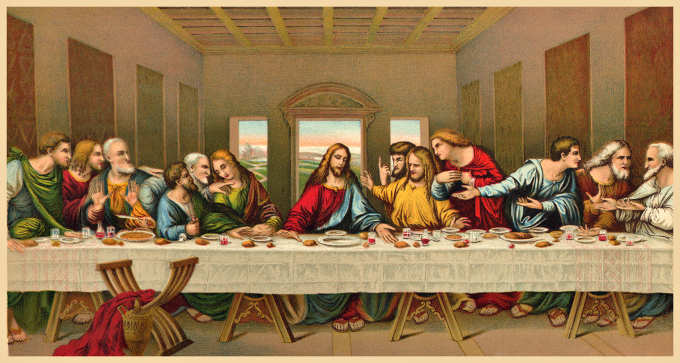

Slide 29
MYSTERY OF FAITH
(Option 1)
We proclaim your Death, O Lord,
and profess your Resurrection
until you come again.
Mass of Glory & Praise - Paul Mason 2010 / Mass of St Francis – Paul Taylor 2010
All music reproduced with permission of Christian Copyright Licensing International Licence No. 219857

Slide 30
MYSTERY OF FAITH
(Option 2)
When we eat this Bread and drink this Cup,
we proclaim your Death, O Lord,
until you come again.
Mass of Glory & Praise - Paul Mason 2010 / Mass of St Francis – Paul Taylor 2010
All music reproduced with permission of Christian Copyright Licensing International Licence No. 219857

Slide 31
MYSTERY OF FAITH
(Option 3)
Save us, Saviour of the world, for by your Cross and Resurrection
you have set us free.
Mass of Glory & Praise - Paul Mason 2010 / Mass of St Francis – Paul Taylor 2010
All music reproduced with permission of Christian Copyright Licensing International Licence No. 219857

Slide 33
Through him, and with him, and in him,
O God, almighty Father, in the unity of the Holy Spirit,
all glory and honour is yours,
for ever and ever.
All: AMEN
Mass of Glory & Praise - Paul Mason 2010 / Mass of St Francis – Paul Taylor 2010
All music reproduced with permission of Christian Copyright Licensing International Licence No. 219857

Slide 34
THE LORD’S PRAYER
Our Father, Who art in heaven
Hallowed be Thy Name;
Thy kingdom come,
Thy will be done,
on earth as it is in heaven.
Give us this day our daily bread,
and forgive us our trespasses,
as we forgive those who trespass against us;
and lead us not into temptation,
but deliver us from evil.

Slide 36
SIGN OF PEACE
The peace of the Lord be with you always.
All: AND WITH YOUR SPIRIT.
Let us offer each other the sign of peace.

Slide 37
BREAKING OF THE BREAD
Lamb of God, you take away the sins of the world:
Have mercy on us.
Lamb of God, you take away the sins of the world:
Have mercy on us.
Lamb of God, you take away the sins of the world:
Grant us peace.
Mass of Glory & Praise - Paul Mason 2010 / Mass of St Francis – Paul Taylor 2010
All music reproduced with permission of Christian Copyright Licensing International Licence No. 219857

Slide 38
COMMUNION
Behold the Lamb of God,
Behold him who takes away the sins of the world.
Blessed are those who are called to the supper of the Lamb.
All: Lord, I am not worthy that you should enter under my roof,
but only say the word
and my soul shall be healed.

Slide 40
All music reproduced with permission of ONE LICENSE No. A-642058 or
Christian Copyright Licensing International Licence No. 219857
Graphics Used with Permission of McCrimmon Publishing Co Ltd.

Slide 41
All music reproduced with permission of ONE LICENSE No. A-642058 or
Christian Copyright Licensing International Licence No. 219857
Graphics Used with Permission of McCrimmon Publishing Co Ltd.

Slide 42
All music reproduced with permission of ONE LICENSE No. A-642058 or
Christian Copyright Licensing International Licence No. 219857
Graphics Used with Permission of McCrimmon Publishing Co Ltd.

Slide 43
All music reproduced with permission of ONE LICENSE No. A-642058 or
Christian Copyright Licensing International Licence No. 219857
Graphics Used with Permission of McCrimmon Publishing Co Ltd.

Slide 45
All music reproduced with permission of ONE LICENSE No. A-642058 or
Christian Copyright Licensing International Licence No. 219857
Graphics Used with Permission of McCrimmon Publishing Co Ltd.

Slide 46
All music reproduced with permission of ONE LICENSE No. A-642058 or
Christian Copyright Licensing International Licence No. 219857
Graphics Used with Permission of McCrimmon Publishing Co Ltd.

Slide 47
All music reproduced with permission of ONE LICENSE No. A-642058 or
Christian Copyright Licensing International Licence No. 219857
Graphics Used with Permission of McCrimmon Publishing Co Ltd.

Slide 48
All music reproduced with permission of ONE LICENSE No. A-642058 or
Christian Copyright Licensing International Licence No. 219857
Graphics Used with Permission of McCrimmon Publishing Co Ltd.

Slide 50
CONCLUDING RITE
The Lord be with you.
All: AND WITH YOUR SPIRIT.
Go ................
All: THANKS BE TO GOD

Slide 51
All music reproduced with permission of ONE LICENSE No. A-642058 or
Christian Copyright Licensing International Licence No. 219857
Graphics Used with Permission of McCrimmon Publishing Co Ltd.

Slide 52
All music reproduced with permission of ONE LICENSE No. A-642058 or
Christian Copyright Licensing International Licence No. 219857
Graphics Used with Permission of McCrimmon Publishing Co Ltd.

Slide 53
All music reproduced with permission of ONE LICENSE No. A-642058 or
Christian Copyright Licensing International Licence No. 219857
Graphics Used with Permission of McCrimmon Publishing Co Ltd.

Slide 54
All music reproduced with permission of ONE LICENSE No. A-642058 or
Christian Copyright Licensing International Licence No. 219857
Graphics Used with Permission of McCrimmon Publishing Co Ltd.

Slide 55
Ash Wednesday
All music reproduced with permission of ONE LICENSE No. A-642058 or
Christian Copyright Licensing International Licence No. 219857
Graphics Used with Permission of McCrimmon Publishing Co Ltd.

