Slide 1
third Sunday of lent
Sunday 3rd March, 2024
Mary Immaculate Parish Quakers Hill-Schofields
We welcome our parishioners and visitors to our Parish today.
All music reproduced with permission of ONE LICENSE No. A-642058 or
Christian Copyright Licensing International Licence No. 219857
Graphics Used with Permission of Susan Daily

Slide 2
Music & Lyrics By: (Insert Details)
All music reproduced with permission of ONE LICENSE No. A-642058 or
Christian Copyright Licensing International Licence No. 219857
Graphics Used with Permission of Susan Daily

Slide 3
Music & Lyrics By: (Insert Details)
All music reproduced with permission of ONE LICENSE No. A-642058 or
Christian Copyright Licensing International Licence No. 219857
Graphics Used with Permission of Susan Daily

Slide 4
Music & Lyrics By: (Insert Details)
All music reproduced with permission of ONE LICENSE No. A-642058 or
Christian Copyright Licensing International Licence No. 219857
Graphics Used with Permission of Susan Daily

Slide 5
Music & Lyrics By: (Insert Details)
All music reproduced with permission of ONE LICENSE No. A-642058 or
Christian Copyright Licensing International Licence No. 219857
Graphics Used with Permission of Susan Daily

Slide 6
INTRODUCTORY RITES
In the name of the Father,
and of the Son,
and of the Holy Spirit.
All: AMEN
All: AND WITH YOUR SPIRIT.

Slide 8
PENITENTIAL ACT
I confess to almighty God
and to you, my brothers and sisters,
that I have greatly sinned,
in my thoughts and in my words,
in what I have done and what I have failed to do,
through my fault, through my fault, through my most grievous fault;
therefore I ask blessed Mary ever-Virgin,
all the Angels and Saints,
and you, my brothers and sisters,
to pray for me to the Lord our God.

Slide 9
PENITENTIAL ACT
May almighty God have mercy
on us,
forgive us our sins,
and bring us to everlasting life.
All: AMEN

Slide 10
PENITENTIAL ACT
Celebrant: Lord have mercy,
All: LORD, HAVE MERCY.
Celebrant: Christ have mercy,
All: CHRIST, HAVE MERCY.
Celebrant: Lord have mercy,
All: LORD, HAVE MERCY.

Slide 12
FIRST READING
Exodus 20: 1-17

Slide 13
RESPONSORIAL PSALM
Ps 18: 8-11
Lord, you have the words of everlasting life.

Slide 14
SECOND READING
Corinthians 1: 22-25

Slide 15
GOSPEL ACCLAMATION
Praise to you, Lord Jesus Christ, king of endless glory! God loved the world so much, he gave us his only Son, that all who believe in him might have eternal life.
Praise to you, Lord Jesus Christ, king of endless glory!

Slide 16
GOSPEL
The Lord be with you.
All: AND WITH YOUR SPIRIT.
A reading from the holy Gospel according to John.
All: Glory to you, O Lord.

Slide 17
GOSPEL
John 2: 13-25

Slide 19
APOSTLES’ CREED
I believe in God,
the Father almighty,
Creator of heaven and earth,
and in Jesus Christ, his only Son,
our Lord, who was conceived by the Holy Spirit, born of the Virgin Mary, suffered under Pontius Pilate, was crucified, died and was buried;
he descended into hell;
on the third day he rose again from the dead;

Slide 20
APOSTLES’ CREED
he ascended into heaven,
and is seated at the right hand of God the Father almighty;
from there he will come to judge
the living and the dead.
I believe in the Holy Spirit,
the holy Catholic Church,
the communion of saints,
the forgiveness of sins,
the resurrection of the body,
and life everlasting. Amen.

Slide 21
PRAYERS OF THE FAITHFUL
R — Lord, hear our prayer

Slide 22
PARISH COMMUNITY PRAYER FOR
THE SEASON OF LENT
Loving God, During the sacred season of Lent, bring us closer to you.
Prepare a place in our homes and hearts for silence and solitude, so that we may re-discover the grace of a prayer-full life.

Slide 23
PARISH COMMUNITY PRAYER FOR
THE SEASON OF LENT
Help us to fast from those things that threaten the well-being of body and soul, remind us of the grace of simplicity.

Slide 24
PARISH COMMUNITY PRAYER FOR
THE SEASON OF LENT
Enlarge our hearts so that we give to those in need and, in doing so, re-discover the grace of gratitude and generosity.
May this season be a
grace-filled time to rekindle our love and faith in you.

Slide 26
OUR FIRST COLLECTION
supports priests currently serving in the Parramatta diocese as well as those who are retired or sick.
OUR SECOND COLLECTION
SUPPORTS OUR ON GOING OVERHEADS AND
DAY TO DAY EXPENSES OF OUR PARISH…

Slide 27
Music & Lyrics By: (Insert Details)
All music reproduced with permission of ONE LICENSE No. A-642058 or
Christian Copyright Licensing International Licence No. 219857
Graphics Used with Permission of Susan Daily

Slide 28
Music & Lyrics By: (Insert Details)
All music reproduced with permission of ONE LICENSE No. A-642058 or
Christian Copyright Licensing International Licence No. 219857
Graphics Used with Permission of Susan Daily

Slide 29
Music & Lyrics By: (Insert Details)
All music reproduced with permission of ONE LICENSE No. A-642058 or
Christian Copyright Licensing International Licence No. 219857
Graphics Used with Permission of Susan Daily

Slide 30
Music & Lyrics By: (Insert Details)
All music reproduced with permission of ONE LICENSE No. A-642058 or
Christian Copyright Licensing International Licence No. 219857
Graphics Used with Permission of Susan Daily

Slide 32
LITURGY OF THE EUCHARIST
Pray, brethren (brothers and sisters) …
All: May the Lord accept the sacrifice at your hands, for the praise and glory of his name, for our good and the good of all his holy Church.
All: AMEN
The Lord be with you.
All: AND WITH YOUR SPIRIT.
Lift up your hearts.
All: WE LIFT THEM UP TO THE LORD
Let us give thanks to the Lord our God.
All: IT IS RIGHT AND JUST.

Slide 34
SANCTUS
Holy, Holy, Holy Lord God of hosts.
Heaven and earth are full of your glory.
Hosanna in the highest.
Blessed is he who comes
In the name of the Lord.
Hosanna in the highest.
Mass of Glory & Praise - Paul Mason 2010 / Mass of St Francis – Paul Taylor 2010
All music reproduced with permission of Christian Copyright Licensing International Licence No. 219857

Slide 35
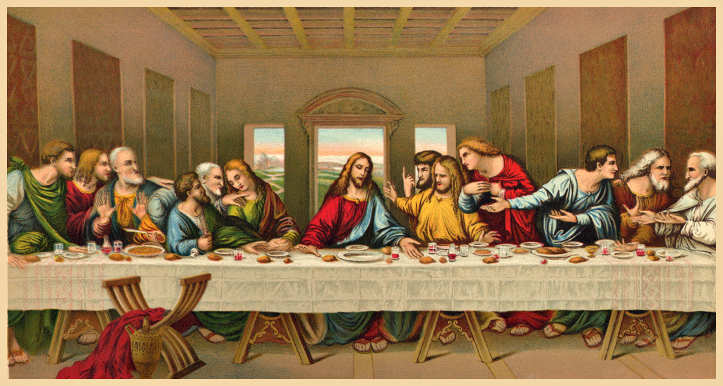

Slide 36
MYSTERY OF FAITH
(Option 1)
We proclaim your Death, O Lord,
and profess your Resurrection
until you come again.
Mass of Glory & Praise - Paul Mason 2010 / Mass of St Francis – Paul Taylor 2010
All music reproduced with permission of Christian Copyright Licensing International Licence No. 219857

Slide 37
MYSTERY OF FAITH
(Option 2)
When we eat this Bread and drink this Cup,
we proclaim your Death, O Lord,
until you come again.
Mass of Glory & Praise - Paul Mason 2010 / Mass of St Francis – Paul Taylor 2010
All music reproduced with permission of Christian Copyright Licensing International Licence No. 219857

Slide 38
MYSTERY OF FAITH
(Option 3)
Save us, Saviour of the world, for by your Cross and Resurrection
you have set us free.
Mass of Glory & Praise - Paul Mason 2010 / Mass of St Francis – Paul Taylor 2010
All music reproduced with permission of Christian Copyright Licensing International Licence No. 219857

Slide 40
Through him, and with him, and in him,
O God, almighty Father, in the unity of the Holy Spirit,
all glory and honour is yours,
for ever and ever.
All: AMEN
Mass of Glory & Praise - Paul Mason 2010 / Mass of St Francis – Paul Taylor 2010
All music reproduced with permission of Christian Copyright Licensing International Licence No. 219857

Slide 41
THE LORD’S PRAYER
Our Father, Who art in heaven
Hallowed be Thy Name;
Thy kingdom come,
Thy will be done,
on earth as it is in heaven.
Give us this day our daily bread,
and forgive us our trespasses,
as we forgive those who trespass against us;
and lead us not into temptation,
but deliver us from evil. Amen.

Slide 42
Celebrant:
Deliver us, Lord, we pray……
All:
For the kingdom, the power and the glory are yours, now and for ever.

Slide 44
SIGN OF PEACE
The peace of the Lord be with you always.
All: AND WITH YOUR SPIRIT.
Let us offer each other the sign of peace.

Slide 45
BREAKING OF THE BREAD
Lamb of God, you take away the sins of the world:
Have mercy on us.
Lamb of God, you take away the sins of the world:
Have mercy on us.
Lamb of God, you take away the sins of the world:
Grant us peace.
Mass of Glory & Praise - Paul Mason 2010 / Mass of St Francis – Paul Taylor 2010
All music reproduced with permission of Christian Copyright Licensing International Licence No. 219857

Slide 46
COMMUNION
Behold the Lamb of God,
Behold him who takes away the sins of the world.
Blessed are those who are called to the supper of the Lamb.
All: Lord, I am not worthy that you should enter under my roof,
but only say the word
and my soul shall be healed.

Slide 48
Music & Lyrics By: (Insert Details)
All music reproduced with permission of ONE LICENSE No. A-642058 or
Christian Copyright Licensing International Licence No. 219857
Graphics Used with Permission of Susan Daily

Slide 49
Music & Lyrics By: (Insert Details)
All music reproduced with permission of ONE LICENSE No. A-642058 or
Christian Copyright Licensing International Licence No. 219857
Graphics Used with Permission of Susan Daily

Slide 50
Music & Lyrics By: (Insert Details)
All music reproduced with permission of ONE LICENSE No. A-642058 or
Christian Copyright Licensing International Licence No. 219857
Graphics Used with Permission of Susan Daily

Slide 51
Music & Lyrics By: (Insert Details)
All music reproduced with permission of ONE LICENSE No. A-642058 or
Christian Copyright Licensing International Licence No. 219857
Graphics Used with Permission of Susan Daily

Slide 52
OUR FIRST COLLECTION
supports priests currently serving in the Parramatta diocese as well as those who are retired or sick.
OUR SECOND COLLECTION
SUPPORTS OUR ON GOING OVERHEADS AND
DAY TO DAY EXPENSES OF OUR PARISH…

Slide 53
Music & Lyrics By: (Insert Details)
All music reproduced with permission of ONE LICENSE No. A-642058 or
Christian Copyright Licensing International Licence No. 219857
Graphics Used with Permission of Susan Daily

Slide 54
Music & Lyrics By: (Insert Details)
All music reproduced with permission of ONE LICENSE No. A-642058 or
Christian Copyright Licensing International Licence No. 219857
Graphics Used with Permission of Susan Daily

Slide 55
Music & Lyrics By: (Insert Details)
All music reproduced with permission of ONE LICENSE No. A-642058 or
Christian Copyright Licensing International Licence No. 219857
Graphics Used with Permission of Susan Daily

Slide 56
Music & Lyrics By: (Insert Details)
All music reproduced with permission of ONE LICENSE No. A-642058 or
Christian Copyright Licensing International Licence No. 219857
Graphics Used with Permission of Susan Daily

Slide 58
CONCLUDING RITE
The Lord be with you.
All: AND WITH YOUR SPIRIT.
Go ................
All: THANKS BE TO GOD

Slide 59
Music & Lyrics By: (Insert Details)
All music reproduced with permission of ONE LICENSE No. A-642058 or
Christian Copyright Licensing International Licence No. 219857
Graphics Used with Permission of Susan Daily

Slide 60
Music & Lyrics By: (Insert Details)
All music reproduced with permission of ONE LICENSE No. A-642058 or
Christian Copyright Licensing International Licence No. 219857
Graphics Used with Permission of Susan Daily

Slide 61
Music & Lyrics By: (Insert Details)
All music reproduced with permission of ONE LICENSE No. A-642058 or
Christian Copyright Licensing International Licence No. 219857
Graphics Used with Permission of Susan Daily

Slide 62
Music & Lyrics By: (Insert Details)
All music reproduced with permission of ONE LICENSE No. A-642058 or
Christian Copyright Licensing International Licence No. 219857
Graphics Used with Permission of Susan Daily

Slide 63
third Sunday of lent
Sunday 3rd March, 2024
All music reproduced with permission of ONE LICENSE No. A-642058 or
Christian Copyright Licensing International Licence No. 219857
Graphics Used with Permission of Susan Daily

