Slide 1
fourth Sunday of lent
Sunday 10 March, 2024
Mary Immaculate Parish Quakers Hill-Schofields
We welcome our parishioners and visitors to our Parish today.
All music reproduced with permission of ONE LICENSE No. A-642058 or
Christian Copyright Licensing International Licence No. 219857
Graphics Used with Permission of Susan Daily

Slide 2
Lyrics & Music By: (Insert Details Here)
All music reproduced with permission of ONE LICENSE No. A-642058 or
Christian Copyright Licensing International Licence No. 219857
Graphics Used with Permission of Susan Daily.

Slide 3
Lyrics & Music By: (Insert Details Here)
All music reproduced with permission of ONE LICENSE No. A-642058 or
Christian Copyright Licensing International Licence No. 219857
Graphics Used with Permission of Susan Daily.

Slide 4
Lyrics & Music By: (Insert Details Here)
All music reproduced with permission of ONE LICENSE No. A-642058 or
Christian Copyright Licensing International Licence No. 219857
Graphics Used with Permission of Susan Daily.

Slide 5
Lyrics & Music By: (Insert Details Here)
All music reproduced with permission of ONE LICENSE No. A-642058 or
Christian Copyright Licensing International Licence No. 219857
Graphics Used with Permission of Susan Daily.

Slide 6
INTRODUCTORY RITES
In the name of the Father,
and of the Son,
and of the Holy Spirit.
All: AMEN
All: AND WITH YOUR SPIRIT.

Slide 8
PENITENTIAL ACT
I confess to almighty God
and to you, my brothers and sisters,
that I have greatly sinned,
in my thoughts and in my words,
in what I have done and what I have failed to do,
through my fault, through my fault, through my most grievous fault;
therefore I ask blessed Mary ever-Virgin,
all the Angels and Saints,
and you, my brothers and sisters,
to pray for me to the Lord our God.

Slide 9
PENITENTIAL ACT
May almighty God have mercy
on us,
forgive us our sins,
and bring us to everlasting life.
All: AMEN

Slide 10
PENITENTIAL ACT
Celebrant: Lord have mercy,
All: LORD, HAVE MERCY.
Celebrant: Christ have mercy,
All: CHRIST, HAVE MERCY.
Celebrant: Lord have mercy,
All: LORD, HAVE MERCY.

Slide 12
FIRST READING
Chronicles 36: 14-16 19-23

Slide 13
RESPONSORIAL PSALM
Ps 136
Let my tongue be silenced, if ever I forgot you!

Slide 14
SECOND READING
Ephesians 2: 4-10

Slide 15
GOSPEL ACCLAMATION
Glory and praise to you, Lord Jesus Christ! God loved the world so much, he gave us his only Son, that all who believe in him might have eternal life.
Glory and praise to you, Lord Jesus Christ!

Slide 16
GOSPEL
The Lord be with you.
All: AND WITH YOUR SPIRIT.
A reading from the holy Gospel according to John.
All: Glory to you, O Lord.

Slide 17
GOSPEL
John 3: 14 - 21

Slide 19
NICENE CREED
I believe in one God, the Father Almighty,
Maker of heaven and earth, and of all things visible and invisible.
I believe in one Lord Jesus Christ, the only begotten Son of God,
Born of the Father before all ages.
God from God, light from light, True God from true God begotten, not made,
consubstantial with the father;

Slide 20
NICENE CREED
Through him all things were made.
For us men and for our salvation he came down from heaven,
And by the Holy Spirit was incarnate of the Virgin Mary, and became man.
For our sake he was crucified under Pontius Pilate,
He suffered death and was buried,
And rose again on the third day.
In accordance with the scriptures

Slide 21
NICENE CREED
He ascended into heaven and is seated at the right hand of the Father.
He will come again in glory to judge the living and the dead
And his kingdom will have no end.
I believe in the Holy Spirit, The Lord, the giver of life,
Who proceeds from the Father and the Son,
Who with the Father and the Son is adored and glorified,

Slide 22
NICENE CREED
Who has spoken through the prophets.
I believe in one, holy, catholic and apostolic Church.
I confess one Baptism for the forgiveness of sins and I look forward to the
resurrection of the dead and the life of the world to come.
Amen.

Slide 23
PRAYERS OF THE FAITHFUL
R — Lord, hear our prayer.

Slide 24
PARISH COMMUNITY PRAYER FOR
THE SEASON OF LENT
Loving God, During the sacred season of Lent, bring us closer to you.
Prepare a place in our homes and hearts for silence and solitude, so that we may re-discover the grace of a prayer-full life.

Slide 25
PARISH COMMUNITY PRAYER FOR
THE SEASON OF LENT
Help us to fast from those things that threaten the well-being of body and soul, remind us of the grace of simplicity.

Slide 26
PARISH COMMUNITY PRAYER FOR
THE SEASON OF LENT
Enlarge our hearts so that we give to those in need and, in doing so, re-discover the grace of gratitude and generosity.
May this season be a
grace-filled time to rekindle our love and faith in you.

Slide 27
OUR FIRST COLLECTION
supports priests currently serving in the Parramatta diocese as well as those who are retired or sick.
OUR SECOND COLLECTION
SUPPORTS OUR ON GOING OVERHEADS AND
DAY TO DAY EXPENSES OF OUR PARISH…

Slide 28
Lyrics & Music By: (Insert Details Here)
All music reproduced with permission of ONE LICENSE No. A-642058 or
Christian Copyright Licensing International Licence No. 219857
Graphics Used with Permission of Susan Daily.

Slide 29
Lyrics & Music By: (Insert Details Here)
All music reproduced with permission of ONE LICENSE No. A-642058 or
Christian Copyright Licensing International Licence No. 219857
Graphics Used with Permission of Susan Daily.

Slide 30
Lyrics & Music By: (Insert Details Here)
All music reproduced with permission of ONE LICENSE No. A-642058 or
Christian Copyright Licensing International Licence No. 219857
Graphics Used with Permission of Susan Daily.

Slide 31
Lyrics & Music By: (Insert Details Here)
All music reproduced with permission of ONE LICENSE No. A-642058 or
Christian Copyright Licensing International Licence No. 219857
Graphics Used with Permission of Susan Daily.

Slide 33
LITURGY OF THE EUCHARIST
Pray, brethren (brothers and sisters) …
All: May the Lord accept the sacrifice at your hands, for the praise and glory of his name, for our good and the good of all his holy Church.
All: AMEN
The Lord be with you.
All: AND WITH YOUR SPIRIT.
Lift up your hearts.
All: WE LIFT THEM UP TO THE LORD
Let us give thanks to the Lord our God.
All: IT IS RIGHT AND JUST.

Slide 35
SANCTUS
Holy, Holy, Holy Lord God of hosts.
Heaven and earth are full of your glory.
Hosanna in the highest.
Blessed is he who comes
In the name of the Lord.
Hosanna in the highest.
Mass of Glory & Praise - Paul Mason 2010 / Mass of St Francis – Paul Taylor 2010
All music reproduced with permission of Christian Copyright Licensing International Licence No. 219857

Slide 36
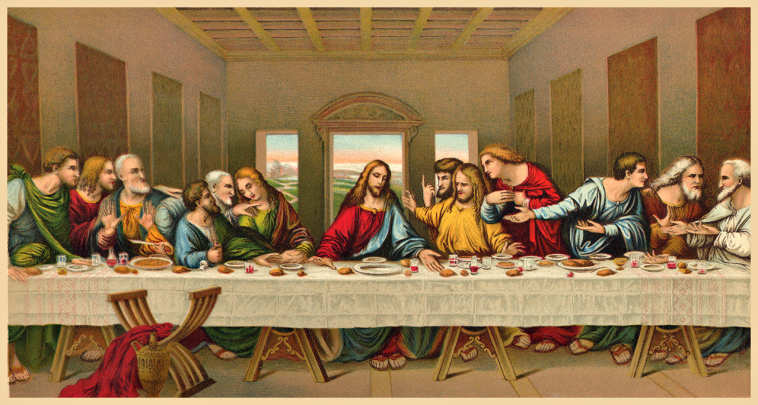

Slide 37
MYSTERY OF FAITH
Save us, Saviour of the world, for by your Cross and Resurrection
you have set us free.
Mass of Glory & Praise - Paul Mason 2010 / Mass of St Francis – Paul Taylor 2010
All music reproduced with permission of Christian Copyright Licensing International Licence No. 219857

Slide 39
Through him, and with him, and in him,
O God, almighty Father, in the unity of the Holy Spirit,
all glory and honour is yours,
for ever and ever.
All: AMEN
Mass of Glory & Praise - Paul Mason 2010 / Mass of St Francis – Paul Taylor 2010
All music reproduced with permission of Christian Copyright Licensing International Licence No. 219857

Slide 40
THE LORD’S PRAYER
Our Father, Who art in heaven
Hallowed be Thy Name;
Thy kingdom come,
Thy will be done,
on earth as it is in heaven.
Give us this day our daily bread,
and forgive us our trespasses,
as we forgive those who trespass against us;
and lead us not into temptation,
but deliver us from evil.

Slide 41
Celebrant:
Deliver us, Lord, we pray…
All:
For the kingdom, the power and the glory are yours, now and for ever.

Slide 43
SIGN OF PEACE
The peace of the Lord be with you always.
All: AND WITH YOUR SPIRIT.
Let us offer each other the sign of peace.

Slide 44
BREAKING OF THE BREAD
Lamb of God, you take away the sins of the world:
Have mercy on us.
Lamb of God, you take away the sins of the world:
Have mercy on us.
Lamb of God, you take away the sins of the world:
Grant us peace.
Mass of Glory & Praise - Paul Mason 2010 / Mass of St Francis – Paul Taylor 2010
All music reproduced with permission of Christian Copyright Licensing International Licence No. 219857

Slide 45
COMMUNION
Behold the Lamb of God,
Behold him who takes away the sins of the world.
Blessed are those who are called to the supper of the Lamb.
All: Lord, I am not worthy that you should enter under my roof,
but only say the word
and my soul shall be healed.

Slide 47
Lyrics & Music By: (Insert Details Here)
All music reproduced with permission of ONE LICENSE No. A-642058 or
Christian Copyright Licensing International Licence No. 219857
Graphics Used with Permission of Susan Daily.

Slide 48
Lyrics & Music By: (Insert Details Here)
All music reproduced with permission of ONE LICENSE No. A-642058 or
Christian Copyright Licensing International Licence No. 219857
Graphics Used with Permission of Susan Daily.

Slide 49
Lyrics & Music By: (Insert Details Here)
All music reproduced with permission of ONE LICENSE No. A-642058 or
Christian Copyright Licensing International Licence No. 219857
Graphics Used with Permission of Susan Daily.

Slide 50
Lyrics & Music By: (Insert Details Here)
All music reproduced with permission of ONE LICENSE No. A-642058 or
Christian Copyright Licensing International Licence No. 219857
Graphics Used with Permission of Susan Daily.

Slide 52
OUR FIRST COLLECTION
supports priests currently serving in the Parramatta diocese as well as those who are retired or sick.
OUR SECOND COLLECTION
SUPPORTS OUR ON GOING OVERHEADS AND
DAY TO DAY EXPENSES OF OUR PARISH…

Slide 53
Lyrics & Music By: (Insert Details Here)
All music reproduced with permission of ONE LICENSE No. A-642058 or
Christian Copyright Licensing International Licence No. 219857
Graphics Used with Permission of Susan Daily.

Slide 54
Lyrics & Music By: (Insert Details Here)
All music reproduced with permission of ONE LICENSE No. A-642058 or
Christian Copyright Licensing International Licence No. 219857
Graphics Used with Permission of Susan Daily.

Slide 55
Lyrics & Music By: (Insert Details Here)
All music reproduced with permission of ONE LICENSE No. A-642058 or
Christian Copyright Licensing International Licence No. 219857
Graphics Used with Permission of Susan Daily.

Slide 56
Lyrics & Music By: (Insert Details Here)
All music reproduced with permission of ONE LICENSE No. A-642058 or
Christian Copyright Licensing International Licence No. 219857
Graphics Used with Permission of Susan Daily.

Slide 58
CONCLUDING RITE
The Lord be with you.
All: AND WITH YOUR SPIRIT.
Go ................
All: THANKS BE TO GOD

Slide 59
Lyrics & Music By: (Insert Details Here)
All music reproduced with permission of ONE LICENSE No. A-642058 or
Christian Copyright Licensing International Licence No. 219857
Graphics Used with Permission of Susan Daily.

Slide 60
Lyrics & Music By: (Insert Details Here)
All music reproduced with permission of ONE LICENSE No. A-642058 or
Christian Copyright Licensing International Licence No. 219857
Graphics Used with Permission of Susan Daily.

Slide 61
Lyrics & Music By: (Insert Details Here)
All music reproduced with permission of ONE LICENSE No. A-642058 or
Christian Copyright Licensing International Licence No. 219857
Graphics Used with Permission of Susan Daily.

Slide 62
Lyrics & Music By: (Insert Details Here)
All music reproduced with permission of ONE LICENSE No. A-642058 or
Christian Copyright Licensing International Licence No. 219857
Graphics Used with Permission of Susan Daily.

Slide 63
fourth Sunday of lent
Sunday 10th March, 2024
All music reproduced with permission of ONE LICENSE No. A-642058 or
Christian Copyright Licensing International Licence No. 219857
Graphics Used with Permission of Susan Daily.

