Slide 1
Pentecost Sunday
Sunday 19th May, 2024
Mary Immaculate Parish Quakers Hill-Schofields We welcome our parishioners and visitors to our Parish today.
All music reproduced with permission of ONE LICENSE No. A-642058 or
Christian Copyright Licensing No. 21987
Graphics Used with Permission of Sr Susan Daily IBVM.

Slide 2
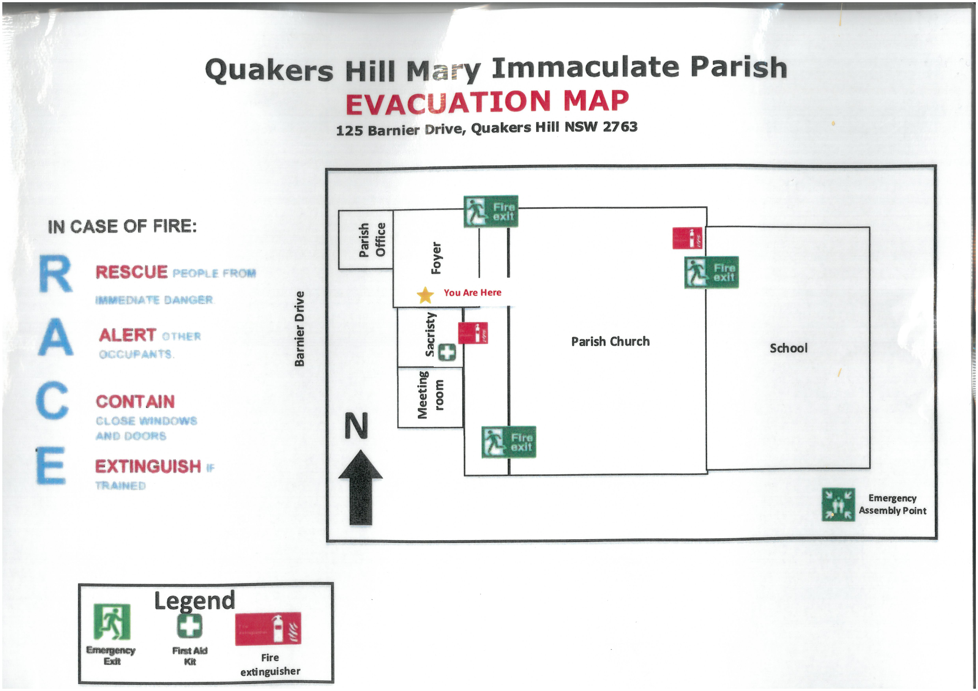
THIS WEEKENDS MASSES WILL BE OFFERED FOR
Recent Death
Anniversaries

Slide 3
Lyrics & Music By:
All music reproduced with permission of ONE LICENSE No. A-642058 or
Christian Copyright Licensing No. 21987
Graphics Used with Permission of Sr Susan Daily IBVM.

Slide 4
Lyrics & Music By:
All music reproduced with permission of ONE LICENSE No. A-642058 or
Christian Copyright Licensing No. 21987
Graphics Used with Permission of Sr Susan Daily IBVM.

Slide 5
Lyrics & Music By:
All music reproduced with permission of ONE LICENSE No. A-642058 or
Christian Copyright Licensing No. 21987
Graphics Used with Permission of Sr Susan Daily IBVM.

Slide 6
Lyrics & Music By:
All music reproduced with permission of ONE LICENSE No. A-642058 or
Christian Copyright Licensing No. 21987
Graphics Used with Permission of Sr Susan Daily IBVM.

Slide 7
INTRODUCTORY RITES
In the name of the Father,
and of the Son,
and of the Holy Spirit.
All: AMEN
All: AND WITH YOUR SPIRIT.

Slide 9
PENITENTIAL ACT
I confess to almighty God
and to you, my brothers and sisters,
that I have greatly sinned,
in my thoughts and in my words,
in what I have done and what I have failed to do,
through my fault, through my fault,

Slide 10
through my most grievous fault;
therefore I ask blessed Mary ever-Virgin,
all the Angels and Saints,
and you, my brothers and sisters,
to pray for me to the Lord our God.

Slide 11
PENITENTIAL ACT
May almighty God have mercy
on us,
forgive us our sins,
and bring us to everlasting life.
All: AMEN

Slide 12
PENITENTIAL ACT
Celebrant: Lord have mercy,
All: LORD, HAVE MERCY.
Celebrant: Christ have mercy,
All: CHRIST, HAVE MERCY.
Celebrant: Lord have mercy,
All: LORD, HAVE MERCY.

Slide 13
GLORIA
Glory to God in the highest, and on earth peace to people of good will.
We praise you,
we bless you,
we adore you,
we glorify you,
we give you thanks for your great glory,

Slide 14
Lord God, heavenly King
O God, almighty Father.
Lord Jesus Christ, Only Begotten Son,
Lord God, Lamb of God, Son of the Father,
you take away the sins of the world,
have mercy on us;
You take away the sins of the world
Receive our prayer;

Slide 15
you are seated at the right hand of the Father, have mercy on us.
For you alone are the Holy One,
you alone are the Lord,
you alone are the Most High,
Jesus Christ,
with the Holy Spirit,
in the glory of God the Father. Amen
Mass of Glory & Praise - Paul Mason 2010 / Mass of St Francis – Paul Taylor 2010
All music reproduced with permission of Christian Copyright Licensing International Licence No. 219857

Slide 17
FIRST READING
Acts 2:1-11

Slide 18
RESPONSORIAL PSALM
Ps 103: 1. 24 9-31
Lord, send out your Spirit and renew the face of the earth.

Slide 19
SECOND READING
Gal 5:16-25

Slide 20
GOSPEL ACCLAMATION
Alleluia, alleluia!
Come, Holy Spirit,
fill the hearts of your faithful and kindle in them the fire of your love.
Alleluia!

Slide 21
GOSPEL
The Lord be with you.
All: AND WITH YOUR SPIRIT.
A reading from the holy Gospel according to John.
All: Glory to you, O Lord.

Slide 22
GOSPEL
Jn 15:26-27;16:12-15

Slide 24
APOSTLES’ CREED
I believe in God,
the Father almighty,
Creator of heaven and earth,
and in Jesus Christ, his only Son,
our Lord, who was conceived by the Holy Spirit, born of the Virgin Mary,

Slide 25
APOSTLES’ CREED
suffered under Pontius Pilate, was crucified, died and was buried;
he descended into hell;
on the third day he rose again from the dead;

Slide 26
APOSTLES’ CREED
he ascended into heaven,
and is seated at the right hand of God the Father almighty;
from there he will come to judge
the living and the dead.
I believe in the Holy Spirit,
the holy Catholic Church,

Slide 27
APOSTLES’ CREED
the communion of saints,
the forgiveness of sins,
the resurrection of the body,
and life everlasting. Amen.

Slide 28
COMMUNITY PRAYER FOR PENTECOST
Come, Holy Spirit, and make us Pentecost people,
Let your wisdom and right judgement guide our decisions and temper our impulses.
Let knowledge and understanding increase our capacity for empathy and compassion.

Slide 29
COMMUNITY PRAYER FOR PENTECOST
Let reverence and awe fill us with gratitude and respect for all of creation.
Give us the courage to witness boldly to our faith in word and deed.

Slide 31
OUR FIRST COLLECTION
supports priests currently serving in the Parramatta diocese as well as those who are retired or sick.
OUR SECOND COLLECTION
SUPPORTS OUR ON GOING OVERHEADS AND
DAY TO DAY EXPENSES OF OUR PARISH…

Slide 32
Lyrics & Music By:
All music reproduced with permission of ONE LICENSE No. A-642058 or
Christian Copyright Licensing No. 21987
Graphics Used with Permission of Sr Susan Daily IBVM.

Slide 33
Lyrics & Music By:
All music reproduced with permission of ONE LICENSE No. A-642058 or
Christian Copyright Licensing No. 21987
Graphics Used with Permission of Sr Susan Daily IBVM.

Slide 34
Lyrics & Music By:
All music reproduced with permission of ONE LICENSE No. A-642058 or
Christian Copyright Licensing No. 21987
Graphics Used with Permission of Sr Susan Daily IBVM.

Slide 35
Lyrics & Music By:
All music reproduced with permission of ONE LICENSE No. A-642058 or
Christian Copyright Licensing No. 21987
Graphics Used with Permission of Sr Susan Daily IBVM.

Slide 37
LITURGY OF THE EUCHARIST
Pray, brethren (brothers and sisters) …
All: May the Lord accept the sacrifice at your hands, for the praise and glory of his name, for our good and the good of all his holy
Church.
All: AMEN

Slide 38
LITURGY OF THE EUCHARIST
The Lord be with you.
All: AND WITH YOUR SPIRIT.
Lift up your hearts.
All: WE LIFT THEM UP TO THE LORD
Let us give thanks to the Lord our God.
All: IT IS RIGHT AND JUST.

Slide 40
SANCTUS
Holy, Holy, Holy Lord God of hosts.
Heaven and earth are full of your glory.
Hosanna in the highest.
Blessed is he who comes
In the name of the Lord.
Hosanna in the highest.
Mass of Glory & Praise - Paul Mason 2010 / Mass of St Francis – Paul Taylor 2010
All music reproduced with permission of Christian Copyright Licensing International Licence No. 219857

Slide 41
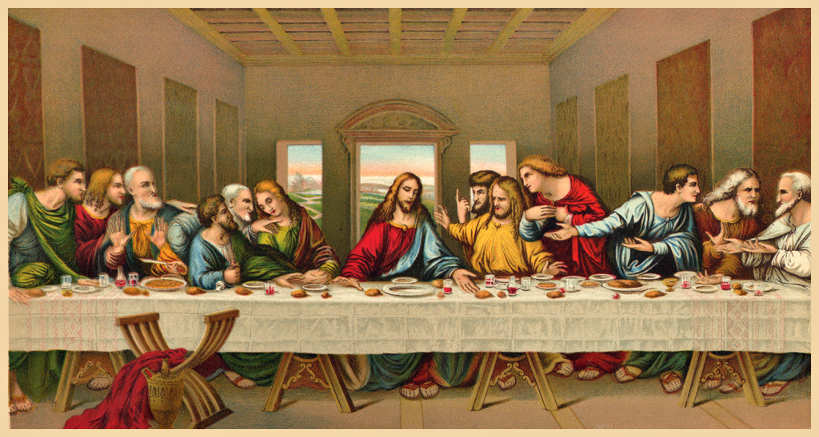

Slide 42
MYSTERY OF FAITH
(Option 1)
We proclaim your Death,
O Lord,
and profess your Resurrection
until you come again.
Mass of Glory & Praise - Paul Mason 2010 / Mass of St Francis – Paul Taylor 2010
All music reproduced with permission of Christian Copyright Licensing International Licence No. 219857

Slide 43
MYSTERY OF FAITH
(Option 2)
When we eat this Bread and drink this Cup,
we proclaim your Death, O Lord,
until you come again.
Mass of Glory & Praise - Paul Mason 2010 / Mass of St Francis – Paul Taylor 2010
All music reproduced with permission of Christian Copyright Licensing International Licence No. 219857

Slide 44
MYSTERY OF FAITH
(Option 3)
Save us, Saviour of the world, for by your Cross and Resurrection
you have set us free.
Mass of Glory & Praise - Paul Mason 2010 / Mass of St Francis – Paul Taylor 2010
All music reproduced with permission of Christian Copyright Licensing International Licence No. 219857

Slide 46
Through him, and with him, and in him,
O God, almighty Father, in the unity of the Holy Spirit,
all glory and honour is yours,
for ever and ever.
All: AMEN
Mass of Glory & Praise - Paul Mason 2010 / Mass of St Francis – Paul Taylor 2010
All music reproduced with permission of Christian Copyright Licensing International Licence No. 219857

Slide 47
THE LORD’S PRAYER
Our Father, Who art in heaven
Hallowed be Thy Name;
Thy kingdom come,
Thy will be done,
on earth as it is in heaven.
Give us this day our daily bread,
and forgive us our trespasses,

Slide 48
THE LORD’S PRAYER
as we forgive those who trespass against us;
and lead us not into temptation,
but deliver us from evil.

Slide 49
Celebrant:
Deliver us, Lord, we pray…
All:
For the kingdom, the power
and the glory are yours, now
and for ever.

Slide 51
SIGN OF PEACE
The peace of the Lord be with you always.
All: AND WITH YOUR SPIRIT.
Let us offer each other the sign of peace.

Slide 52
BREAKING OF THE BREAD
Lamb of God, you take away the sins of the world:
Have mercy on us.
Lamb of God, you take away the sins of the world:
Have mercy on us.
Mass of Glory & Praise - Paul Mason 2010 / Mass of St Francis – Paul Taylor 2010
All music reproduced with permission of Christian Copyright Licensing International Licence No. 219857

Slide 53
BREAKING OF THE BREAD
Lamb of God, you take away the sins of the world:
Grant us peace.
Mass of Glory & Praise - Paul Mason 2010 / Mass of St Francis – Paul Taylor 2010
All music reproduced with permission of Christian Copyright Licensing International Licence No. 219857

Slide 54
COMMUNION
Behold the Lamb of God,
Behold him who takes away the sins of the world.
Blessed are those who are called to the supper of the Lamb.

Slide 55
COMMUNION
All: Lord, I am not worthy that you should enter under my roof,
but only say the word
and my soul shall be healed.

Slide 57
Music & Lyrics By: (Please Insert Details Here)
All music reproduced with permission of ONE LICENSE No. A-642058 or
Christian Copyright Licensing No. 219857
Graphics Used with Permission of Sr Susan Daily IBVM.

Slide 58
Music & Lyrics By: (Please Insert Details Here)
All music reproduced with permission of ONE LICENSE No. A-642058 or
Christian Copyright Licensing No. 219857
Graphics Used with Permission of Sr Susan Daily IBVM.

Slide 59
Music & Lyrics By: (Please Insert Details Here)
All music reproduced with permission of ONE LICENSE No. A-642058 or
Christian Copyright Licensing No. 219857
Graphics Used with Permission of Sr Susan Daily IBVM.

Slide 60
Music & Lyrics By: (Please Insert Details Here)
All music reproduced with permission of ONE LICENSE No. A-642058 or
Christian Copyright Licensing No. 219857
Graphics Used with Permission of Sr Susan Daily IBVM.

Slide 61
OUR FIRST COLLECTION
supports priests currently serving in the Parramatta diocese as well as those who are retired or sick.
OUR SECOND COLLECTION
SUPPORTS OUR ON GOING OVERHEADS AND
DAY TO DAY EXPENSES OF OUR PARISH…

Slide 62
Lyrics & Music By:
All music reproduced with permission of ONE LICENSE No. A-642058 or
Christian Copyright Licensing No. 21987
Graphics Used with Permission of Sr Susan Daily IBVM.

Slide 63
Lyrics & Music By:
All music reproduced with permission of ONE LICENSE No. A-642058 or
Christian Copyright Licensing No. 21987
Graphics Used with Permission of Sr Susan Daily IBVM.

Slide 64
Lyrics & Music By:
All music reproduced with permission of ONE LICENSE No. A-642058 or
Christian Copyright Licensing No. 21987
Graphics Used with Permission of Sr Susan Daily IBVM.

Slide 65
Lyrics & Music By:
All music reproduced with permission of ONE LICENSE No. A-642058 or
Christian Copyright Licensing No. 21987
Graphics Used with Permission of Sr Susan Daily IBVM.

Slide 66
CONCLUDING RITE
The Lord be with you.
All: AND WITH YOUR SPIRIT.
Go ................
All: THANKS BE TO GOD

Slide 67
Lyrics & Music By:
All music reproduced with permission of ONE LICENSE No. A-642058 or
Christian Copyright Licensing No. 21987
Graphics Used with Permission of Sr Susan Daily IBVM.

Slide 68
Lyrics & Music By:
All music reproduced with permission of ONE LICENSE No. A-642058 or
Christian Copyright Licensing No. 21987
Graphics Used with Permission of Sr Susan Daily IBVM.

Slide 69
Lyrics & Music By:
All music reproduced with permission of ONE LICENSE No. A-642058 or
Christian Copyright Licensing No. 21987
Graphics Used with Permission of Sr Susan Daily IBVM.

Slide 70
Lyrics & Music By:
All music reproduced with permission of ONE LICENSE No. A-642058 or
Christian Copyright Licensing No. 21987
Graphics Used with Permission of Sr Susan Daily IBVM.

Slide 71
Pentecost Sunday
Sunday 19th May, 2024
All music reproduced with permission of ONE LICENSE No. A-642058 or
Christian Copyright Licensing No. 21987
Graphics Used with Permission of Sr Susan Daily IBVM.

